Slide 1

CEIS150
Stock Tracking Program
Jaclyn Latshaw
July 2024

Slide 2

Introduction
Stocks have been important in the business sector for centuries and are great for investments.
Programs can be built to keep track of personal investment in stock.
These programs can also be utilized to track any company’s stock to make decisions based on activity over time.

Slide 3
Initial Stock Program
A rudimentary stock program was first created to display user’s name and basic information relating to the statistics of the stock.
Stock pricing was entered via a list and used a basic function to display minimum price, how many stocks were greater than the minimum price, and the total.

Slide 4
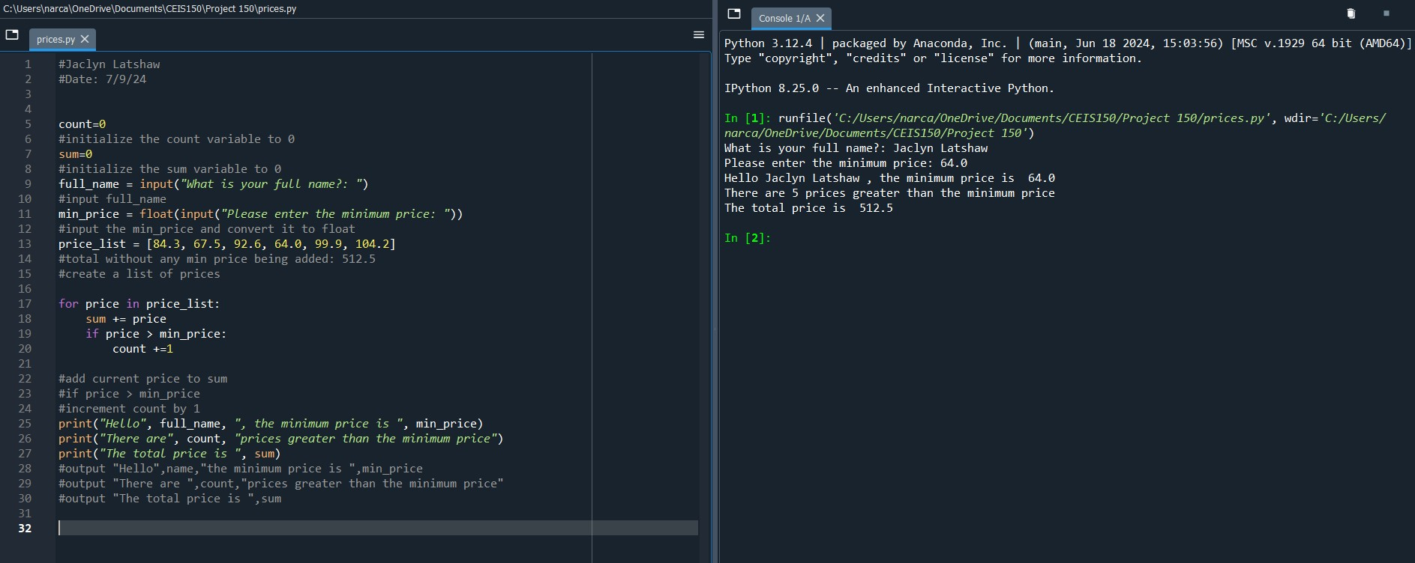
Initial Stock Program

Slide 5
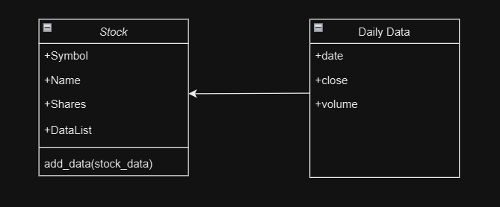
Class Diagram
The next step was to create a diagram outlining the concepts of what classes and properties were needed for the stock program.
This also shows the relationship between the classes. Notice that the Daily Data class is showing inclusion into the Stock class since it will be used as a data type in the program.

Slide 6
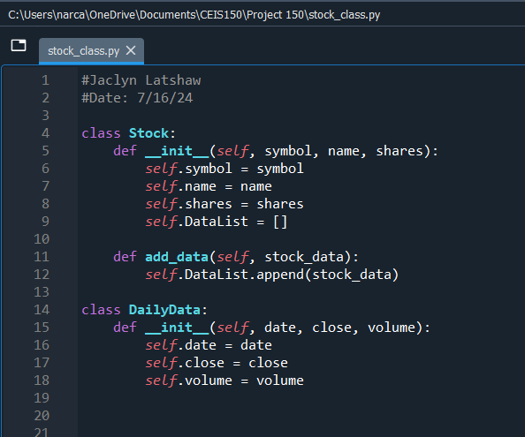
Class Code
Now, I could begin coding my program officially.
First, I had to use definitions to define my classes within the program using the properties I listed in my diagram.
The starting definitions for each class use the “__init__” function.
The “add_data” definition pulls the information from the Stock class definition to add onto the program. This is known as inheritance.

Slide 7
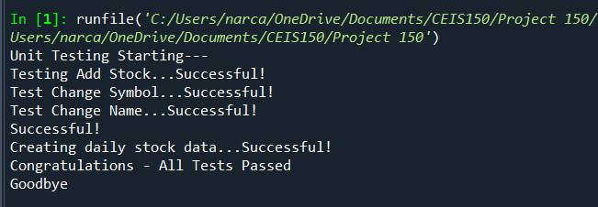
Unit Test
A unit test was created in order to test this initial program to make sure that it functioned properly. Any errors would need to be fixed. Below is the successful output of the unit test showing that the program is running as expected.

Slide 8

Stock Menu Program
A menu was developed to be able to do different functions within the program itself. This allows the user to select an option of what they wanted to do. The programming of the menu was broken down into sections.
Stock Menu items included:
  Add Stock
  Delete Stock
  List Stock
  Add Daily Stock Data
  Show Chart
  Investor Type
  Load Data
  Exit Program

Slide 9
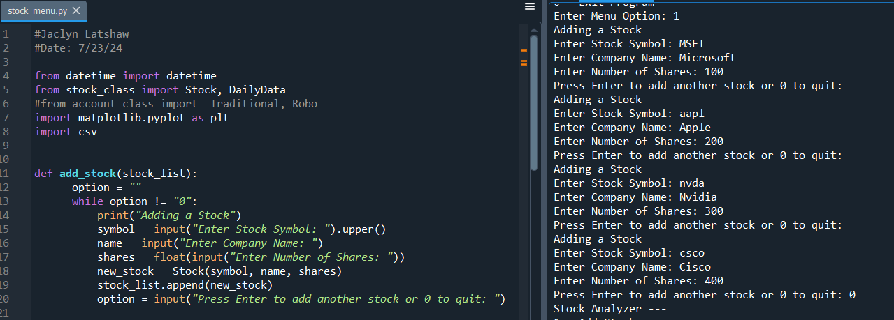
Adding a Stock
Now, I had to write the code to add stocks to the program. I tested this code by running the program and added 4 stocks.

Slide 10
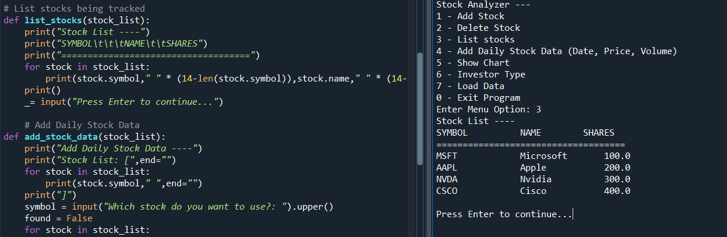
Listing Stocks
A stock program needs to be able to show you what stocks it is holding. I added this option to show which of the stocks were entered. This allows the user to see the stock symbol, company name, and how many shares were entered and displayed as a chart.

Slide 11
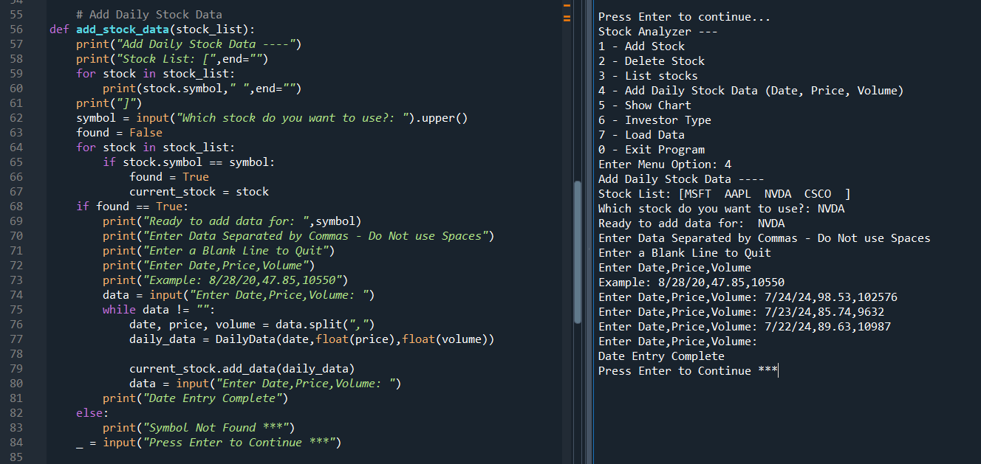
Daily Data
Recalling from the classes diagram, the Daily Data class became a menu option of its own to be used in the program to enter date, price, and volume of the stock. Instructions for entry and special prompts were added to help the user navigate the program.

Slide 12
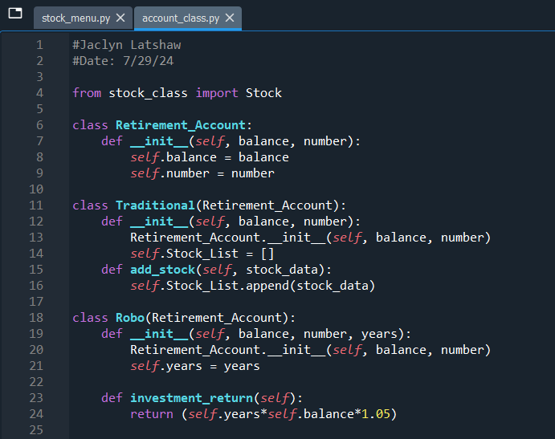
Inherited Classes
Once again, I utilized inheritance to pass properties and methods through the definitions while adding new properties and methods. This allowed the user to set the investment type, option # 6.
Notice that this is a separate program than the stock menu itself. The stock menu pulls in this file to determine the type while the account class program uses the information from the stock menu program.

Slide 13
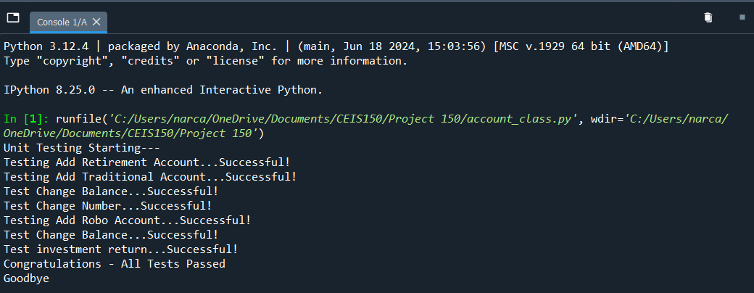
More Unit Tests
Another unit test was coded and performed to test the program so far. It is very important to test your program as you go. This allows errors to be caught early on to avoid future frustrations trying to find where the error originates.

Slide 14
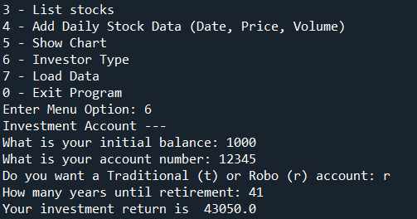
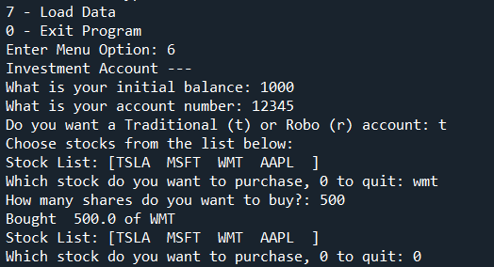
Investment Type Options
Here is an example of the output of the Investment Type for each of the options available. This is another way to test the program to see if it is running correctly.
Notice how the different investment types prompt the user with different questions.

Slide 15
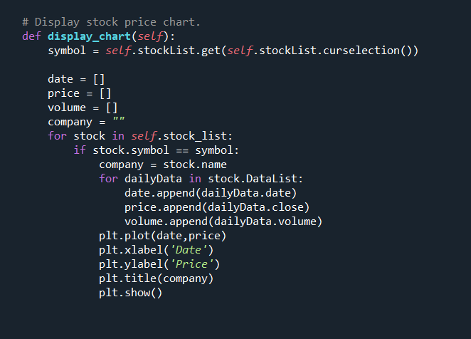
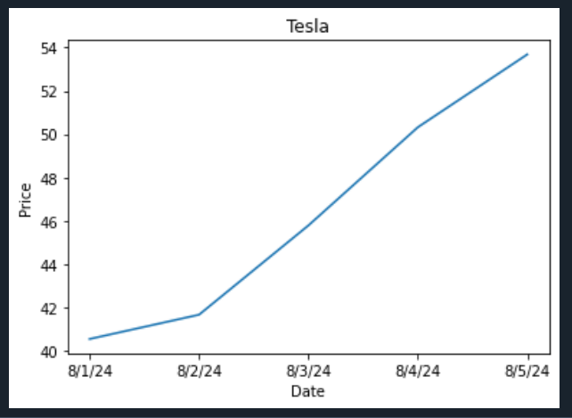
Display Chart
Option #5 allows the user to see a visual representation of how the stock is performing based on the information the program has been given.

Slide 16
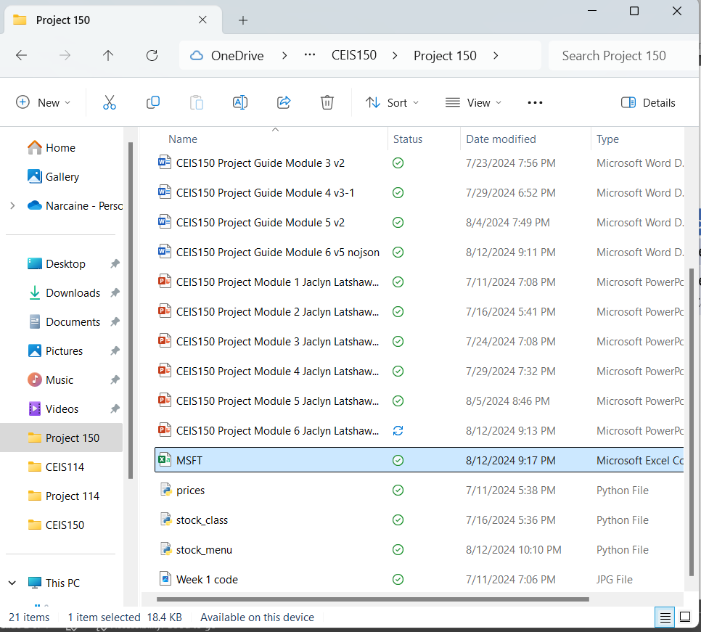
Downloading Information
Yahoo Finance allows you to download stock data into an Excel file. We can use this file to add to our stock program. The program can read the information that this file contains and store the information.
This is especially useful if you wanted to see how a stock has performed over time. Just import the data into the stock program and display the chart. The following slides will show you the import process.

Slide 17
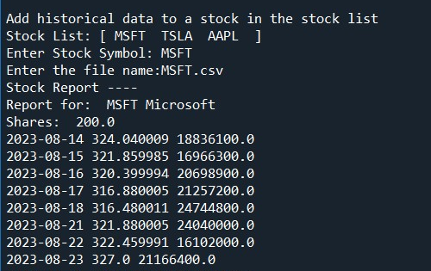
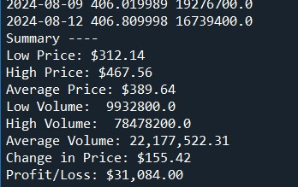
Importing data
When importing the data, the user will select option #7 and the program will ask the user which of the entered stocks should it import the data to. The user will also have to type the file name including the extension in order for the text-based program to import the data.
The program also then displays some important information that can be useful to the user about the stock information they just imported. This is listed after the import information.
Due to the amount of information that was displayed during import, I have only shown a portion of the import.

Slide 18
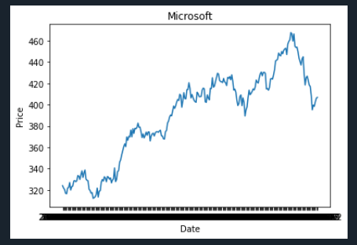
Importing Data - Chart
Here is another example of using the show chart option in the stock menu to display the historical data that was imported.

Slide 19
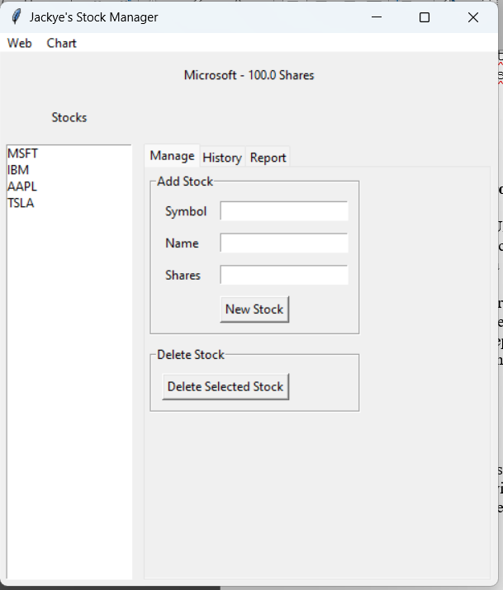
Stocks in GUI
While the program is fairly easy to use as a text-based program. Most people would rather use an actual polished program where they can enter the information, click on buttons, and access menus. A graphical user interface (GUI) was created using the original program as a guide. The same functions that were developed up to this point can be accessed and used to oversee the stocks entered.

Slide 20
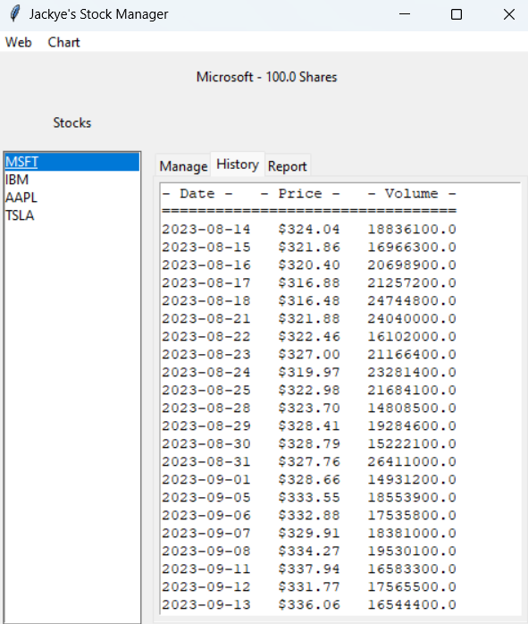
History Tab
Even the historical data that we imported from Yahoo Finance can be accessed using the History tab.
Please note that the stock must be selected first before changing to the History tab.
You can even import the historical data from the Web menu at the top.

Slide 21
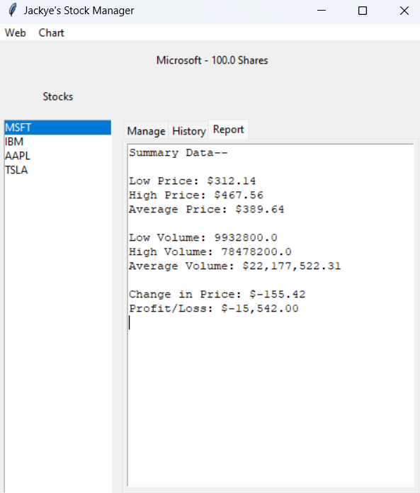
Report Complete
The information that was originally displayed after the import information in the text-based program can be found under the Report tab.

Slide 22
Career Skills Developed
Python Programming Skills
GUI Skills
Developing Menus within Python
Organization and Project Planning

Slide 23
Challenges
Indentation plays a big role in programming and can easily change how a program functions. I did have a bit of trouble with indentation that did cause some minor frustrations while building the program and running tests.
Developing the GUI was a bit challenging because I didn’t have any prior experience. However, I did find the process informational and fascinating.

Slide 24

Conclusion
Programming can be a rewarding experience in developing programs that can be used in everyday life and in different industries. A stock program can be easily built and utilized to track stocks and their performance. This can help users make more informed decisions while navigating the world of investments.

