Slide 1

Fundamentals of Information System Security
SEC285
Final Project
Jaclyn Latshaw
April 2025

Slide 2

Introduction
Security is a crucial aspect of the tech world. Throughout this course, I explored the basics of information system security and the various threats that can impact computers and networks. I delved into topics like encryption, firewalls, security policies, multifactor authentication, and vulnerability assessments. I also worked on several practical projects that allowed me to apply these concepts in real-world scenarios. The upcoming slides will walk you through my week-by-week journey and how I applied these concepts.

Slide 3
Asymmetric Key Encryption
Grasping the concept of cryptography is essential for protecting systems from threats. Encryption secures files, mitigates risks, and ensures that data is not easily accessed by unauthorized users. The process of encryption takes plaintext, unencrypted data, and scrambles it so that it becomes unreadable, resulting in what is known as ciphertext. Cryptography offers protection for data in use, data in transit, and data at rest, with keys generated to decrypt or unscramble the data.
Symmetric cryptography uses the same key to encrypt and decrypt data. Asymmetric cryptography involves a pair of mathematically related keys, public and private, to encrypt and decrypt data. In the next few slides, I will demonstrate asymmetric cryptography in a Linux system.

Slide 4
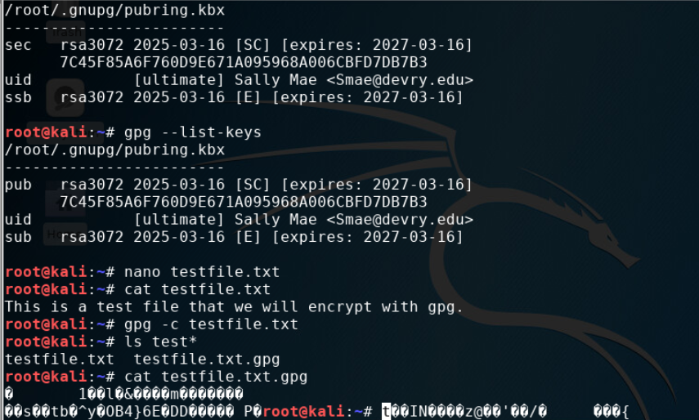
File Encryption
This screenshot demonstrates the encryption process of the file. The data file was created using Nano text editor. Using the Gnu Privacy Guard (GPG), I was able to successfully encrypt the text file. The image shows both the plaintext and the encrypted text. The keys were generated prior to this process using GPG.

Slide 5
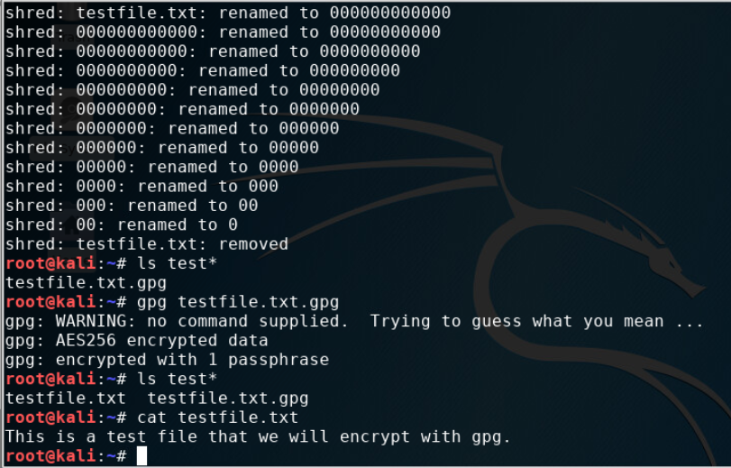
File Decryption
At this point, the original unencrypted file is removed to make sure the data remains secure. Now, the only way to view the contents of the text file is to decrypt it. Using GPG, I decrypted the file and displayed the contents.

Slide 6
Stateful Firewall
Understanding the significance of firewalls is crucial for maintaining cybersecurity. Firewalls are versatile, functioning as either software or hardware, and are designed to control and filter malicious traffic from entering a device or network.
A stateless firewall examines incoming packets of information. It accepts or denies these packets based on the rules set by the administrator, but it does not store information about connections. A stateful firewall keeps a record of the state of connection between an internal computer and an external device. This record of the connection and the rules set by the admin allow the firewall to make decisions on the incoming traffic.
In the follow slides, I will demonstrate the configuration of a stateful firewall on a Linux system and testing it via a Kali Linux system.

Slide 7
Question
What effect does the sudo iptables --policy INPUT DROP command have on the access to computing resources?
This command sets it so that any incoming packet that doesn’t conform to the set of rules gets dropped without a response. The rules act like filters on the incoming traffic. When rules are set, the admin can block hackers by explicitly telling the system to block or allow certain traffic. This makes it harder for hackers to get easy access to your system and increases the security.

Slide 8
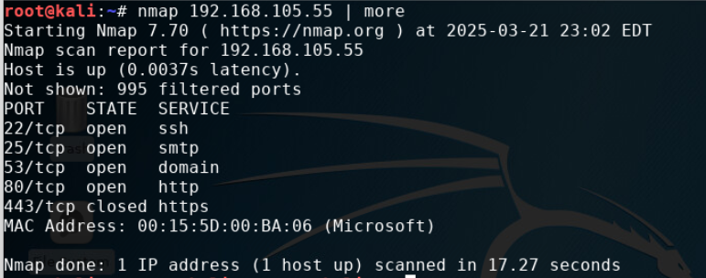
Nmap Scan
After testing the connections of the Linux Server and Kali Linux virtual machines, the ports were verified using Nmap. The first configuration drops all incoming traffic to the Linux Server VM. Then, all configurations were flushed from the system and the firewall was then reconfigured to allow certain ports to accept incoming traffic. The Iptables were saved to make sure the configurations would continue after reboot. The number of open ports were significantly reduced to the list in the screenshot.

Slide 9
Bring Your Own Device (BYOD)
Security Policy
Every company and organization establishes policies that provide guidelines for employees to follow, enabling them to actively safeguard the data they handle. Some companies permit employees to use their personal devices, with the IT department configuring these devices to ensure the company's private data remains secure.
It is important to be able to read and understand these security policies. However, it is equally important to be able to write the policy. In the following slides, I have outlined my own security policy involving the practice of bringing your own device. My policy was created using the SANS security policy template for the Bring Your Own Device security policy developed by the SANS Institute.

Slide 10
1. Overview:
Tablets, smartphones, and laptops are widely used in our organization to enhance productivity and flexibility. However, these devices are vulnerable to threats such as phishing attacks, mobile malware, data leakage, social engineering, and insider threats. To mitigate these risks, we require encryption of data, strong password policies, up-to-date anti-malware software, and remote wipe capabilities for lost or stolen devices. Employees must be trained to recognize and avoid these threats to ensure the security of company data.
2. Purpose:
The primary goal of our IT security policy is to safeguard the confidentiality, integrity, and availability (CIA) of our data. This BYOD security policy is designed to identify and manage personal devices that may introduce vulnerabilities to our organization's data systems. By promptly detecting and addressing these vulnerabilities, we can significantly reduce the potential attack vectors that could be exploited by threat actors. This proactive approach helps minimize security risks and ensures the robust protection of our computing resources.

Slide 11
3. Scope:
This BYOD policy applies to all personnel and departments within the organization that use personal devices such as smartphones, tablets, and laptops to access the company network. Only devices that have received formal approval from the IT department are permitted on the network. Approved activities on personal devices include accessing work emails, company applications, and other authorized work-related tasks. The IT department is responsible for granting permission to use personal devices, ensuring they meet security requirements and comply with company policies.
4. Policy:
All BYOD devices are subject to security assessments before being granted access to the network. To be compliant, a device must meet the following requirements:
Operating System: The device must be running Microsoft Windows and/or Android operating systems with the latest available updates installed.
Antivirus Software: The device must have up-to-date antivirus software.
Firewall: The device must have an active firewall.
Devices that do not meet these requirements are considered noncompliant and will not be granted access to the network. Noncompliant devices must undergo a remediation process to address the areas of noncompliance. The responsibility for remediation falls on the device owner, who must take the necessary steps to bring their device into compliance. Once the remediation process is complete, the device will be reassessed for compliance and, if it meets all the requirements, will be granted access to the network. Please contact the IT department for a list of approved antivirus software.

Slide 12
5. Policy Compliance:
The IT department will ensure adherence to this policy through various measures, including but not limited to regular inspections, the use of intrusion detection systems, and both internal and external audits. Employees who fail to comply with the security policy may face disciplinary measures per employee handbook procedures. These disciplinary measures include a verbal or written reprimand, disciplinary meeting, and penalties. Violations of this policy can result in consequences up to and including termination of employment. Please refer to employee handbook for details on these procedures.
6. Related Standards, Policies, and Processes:
This BYOD policy is linked to several key standards and regulations to ensure comprehensive security and compliance:
HIPAA (Health Insurance Portability and Accountability Act): Ensures that personal devices accessing protected health information (PHI) comply with stringent security measures, such as encryption and access controls, to protect the confidentiality, integrity, and availability of PHI.
PCI-DSS (Payment Card Industry Data Security Standard): Requires personal devices used for processing payment information to adhere to strict security requirements, including maintaining a secure network and protecting cardholder data, to reduce the risk of data breaches.
NIST (National Institute of Standards and Technology) Guidelines: Provides comprehensive guidelines on mobile device security, enhancing overall security measures for personal devices.
Integrating these standards into our BYOD policy strengthens our security posture and ensures compliance with relevant regulations, protecting the organization from potential legal and financial repercussions.

Slide 13
7. Definitions and Terms:
Antivirus Software: A program designed to detect and destroy computer viruses and other malicious software.
BYOD (Bring Your Own Device): A policy that allows employees to use their personal devices, such as smartphones, tablets, and laptops, for work purposes and to access company resources.
Encryption: The process of converting information or data into a code, especially to prevent unauthorized access.
Firewall: A network security system that monitors and controls incoming and outgoing network traffic based on predetermined security rules.
Malware: Malicious software designed to harm, exploit, or otherwise compromise the security of a device or network.
PHI (Protected Health Information): Any information about health status, provision of health care, or payment for health care that can be linked to an individual, as defined by HIPAA.
Phishing: Attempts to obtain sensitive information by disguising as a trustworthy entity in electronic communications.
Remediation: The process of correcting or addressing a security issue or vulnerability to bring a device or system into compliance with security policies.
Remote Wipe Capabilities: The ability to remotely erase data from a device, typically used when a device is lost or stolen to protect sensitive information.
Social Engineering: Manipulative tactics used to trick employees into revealing confidential information or performing actions that compromise security.
Threat Actor: An individual or group that poses a threat to the security of information systems by attempting to gain unauthorized access or cause harm.
Vulnerabilities: Weaknesses or flaws in a system or device that can be exploited by attackers to gain unauthorized access or cause harm.
8. Revision History:
Date of change | Responsible | Summary of change
August 2019 | SANS policy team | Updated and converted to new format
March 2025 | Jackye Latshaw | Updated to include details related to BYOD Policy

Slide 14
Multifactor Authentication (MFA)
Everyone needs to verify their identity at some point. Traditionally, entering a username and password was sufficient to access an account on the Internet. However, attackers can easily use the same credentials, leading to the rise of multifactor authentication. This method requires additional verification to ensure the person attempting to access an account is indeed authorized. Users must provide two or more verification methods to gain access.
The key categories of multifactor authentication are: something you know, something you have, and something you are. Passwords, PINs, and security questions fall under the "something you know" category. Smartphones and smartcards are examples of "something you have," including codes sent to a phone for authentication. Biometrics, such as fingerprint scans or facial recognition, represent "something you are." Applications may request a fingerprint scan instead of sending a code.
In the following slide, I will demonstrate setting up multifactor authentication using Google Authenticator in conjunction with an Ubuntu VM.

Slide 15
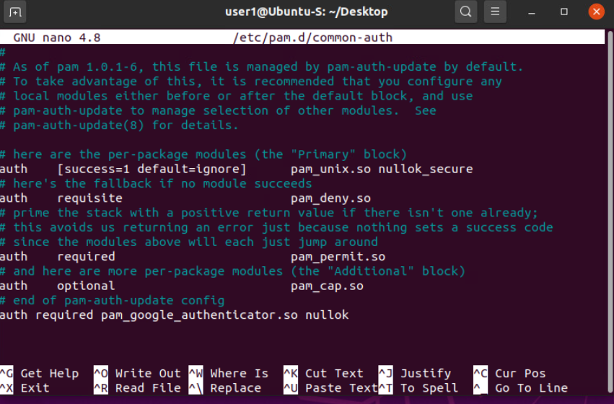
Common-auth Configuration File
Google Authenticator is an app that generates one-time passwords (OTP). After downloading this app, I went through the process of adding a user account to the system and adding them to the sudo group. I rebooted the system and finished the setup of the new user. I edited a configuration file that is used for authentication settings to use the Google Authenticator app which is shown in the screenshot provided. The authenticator app was setup to work with the Ubuntu VM.

Slide 16
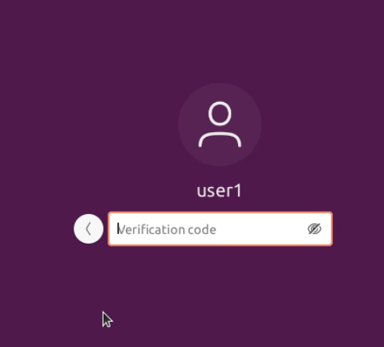
MFA Logon Screen
The system was once again rebooted. This time I was taken to a login screen that requested the password and then, it requested the verification code. The Google Authenticator app provided a new code every 30 seconds. I entered the verification code the app provided and was able to access the user account.

Slide 17
Vulnerability Assessment
The concept of vulnerability assessment is centered on identifying weaknesses that can be exploited to gain unauthorized access and deliver successful attacks on a system. Conducting a vulnerability assessment is crucial to an organization's integrity, as it evaluates potential harm and mitigates risks. This assessment can be performed using various tools, such as a port scanner, protocol analyzer, or vulnerability scanner. Regular assessments help ensure that vulnerabilities are promptly addressed, maintaining the security and resilience of the system.
In the following slides, I will demonstrate the use of three vulnerability assessment tools to evaluate the types of risks that were found on a Linux Server and Kali Linux VM.

Slide 18
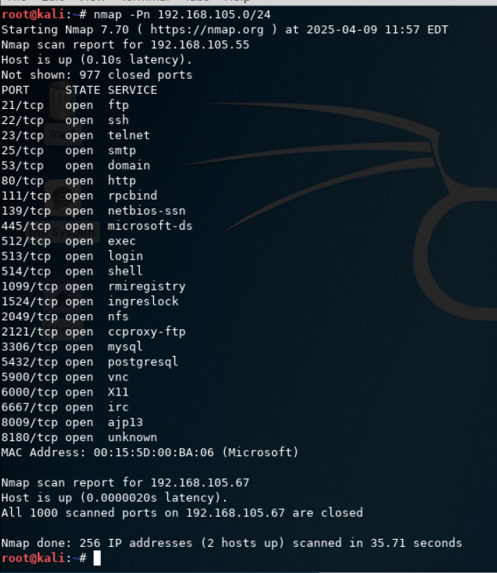
Nmap
The first thing that needed to be found was the IP addresses of both the Kali and Linux Server VMs. These IP addresses will be used to scan the VMs individually.
The screenshot shows that each IP address was scanned using nmap. Nmap is used to identify IP addresses that are in use on a network. The longer scan result is for the Linus Server VM and the shorter result is for the Kali Linux VM.

Slide 19
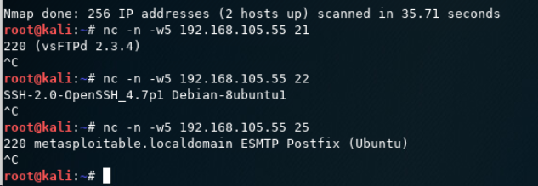
NetCat
NetCat is used to gain information about FTP (File Transfer Protocol), SSH (Secure Shell) , and SMTP (Simple Mail Transfer Protocol) applications that are found in an Nmap scan. This is known as banner grabbing when a program is used to intentionally gather information from a banner, the message that a service transmits when another program connects to it. This can be used to get a list of services and systems that operate on the server. Attackers can use this information to exploit vulnerabilities in these programs especially since they can find out what version is present in the system. The command is specifically targeting the ports 21, 22, and 25. NetCat responds with the applications found on the port specified.

Slide 20
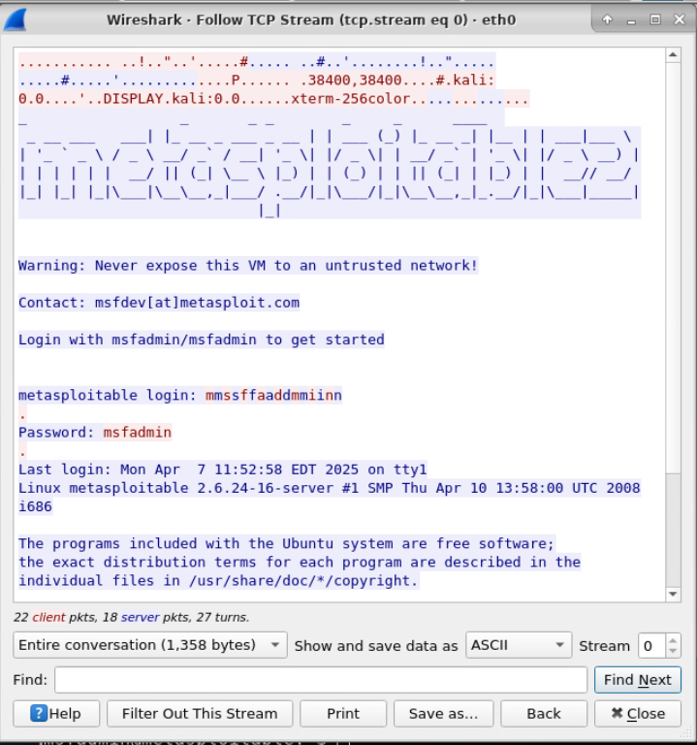
Wireshark
Wireshark is a packet sniffing tool that is used to analyze network traffic. I used this tool to follow Telnet packets. Telnet transfers packets in plaintext which allowed me to view the username and password of the Linux Server VM. This shows how important it is to encrypt data in transit because the data can be intercepted like this and exposes the login credentials as seen in the screenshot.

Slide 21
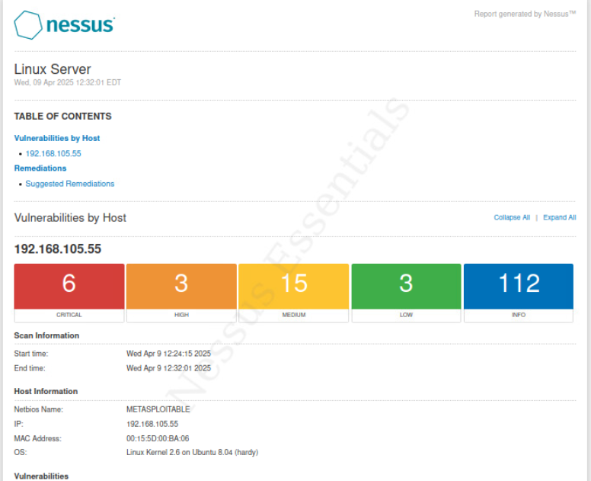
Nessus
Nessus is a free to use vulnerability scanner. This can provide a starting point into the assessment of a system. The screenshot shows the results for the Linux Server VM. This program provides a visual that can help an admin prioritize risks based on the severity of the level.

Slide 22
Challenges
I found the weekly labs to be straightforward and easy to follow, with clear instructions. The only real challenge was understanding the relevance of each lab to the concepts I was learning. At times, I felt overwhelmed by the amount of information and found myself confusing topics from different classes, as they covered similar material. However, this project helped me consolidate the information and gain a better understanding of the concepts.

Slide 23
Career Skills
This course has significantly enhanced my career skills, particularly in risk assessment and management. I further developed my command line knowledge and practice, which is essential for efficient system navigation. The labs deepened my understanding of risk and vulnerability assessment, encryption techniques, and policy writing. These experiences have strengthened my InfoSec skills, preparing me to tackle real-world challenges with confidence. I now feel equipped to apply these skills in diverse professional settings.

Slide 24
Conclusion
I thoroughly enjoyed this course and the weekly labs. The information seamlessly integrated concepts from my previous courses, enhancing my understanding. It was rewarding to apply the material to various scenarios each week. I now have a deeper grasp of risk assessment and management, and I feel more confident in handling situations similar to those encountered in this project. I am eager to continue my education in these areas and am excited about the opportunities this newfound knowledge will bring to my career and personal growth.

Slide 25
References
ACI Learning / Infosec Learning Inc Skill Labs
Ciampa, M., Ph. D. (2018). CompTIA Security+ Guide to Network Security Fundamentals (6th ed.) [Ebook]. Cengage.
GeeksforGeeks. (2024, July 3). iptables command in Linux with Examples. GeeksforGeeks. https://www.geeksforgeeks.org/iptables-command-in-linux-with-examples/

