Slide 1

CEIS295
Data Structures and Algorithms
Jaclyn Latshaw
December 17, 2025

Slide 2
Introduction
This project traces a clear progression through the foundations of data structures and algorithms. Beginning with Module 1, we explore Abstract Data Types and arrays, focusing on operations and efficiency through Big O notation. Module 2 introduces linked lists, comparing singly and doubly linked structures and their performance against arrays. In Module 3, we examine stacks and queues, highlighting their real‑world applications in order processing. Module 4 expands into sorting algorithms, contrasting simple methods like Bubble and Insertion with advanced techniques such as Quick, Merge, and Shell Sort. Module 5 shifts to searching, comparing linear and binary search while introducing hashing for fast lookups. Module 6 builds on this by presenting binary trees, their properties, and traversal methods, with special emphasis on the Binary Search Tree. Finally, Module 7 explores graph theory, covering paths, cycles, and representations that model complex networks. Together, these modules demonstrate how data structures evolve from linear to hierarchical to networked forms, each offering unique strengths for solving computational problems.

Slide 3
Module 1
Introduction to Abstract Data Types (ADT’s)
  Defined by what operations are done, not how they are done
Arrays
  Adding and Removing records (append & remove operations)
  Returning records
  Resizing
Big O Notation
  Best case scenarios – minimum possible # of operations
  Worst case scenarios – maximum possible # of operations

Slide 4
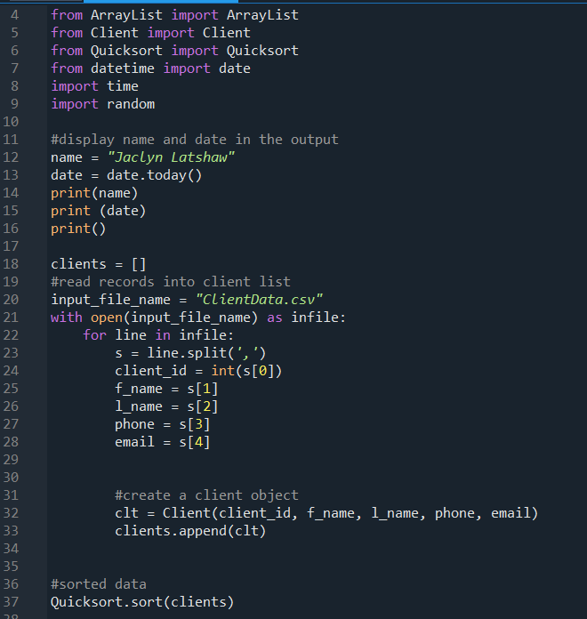
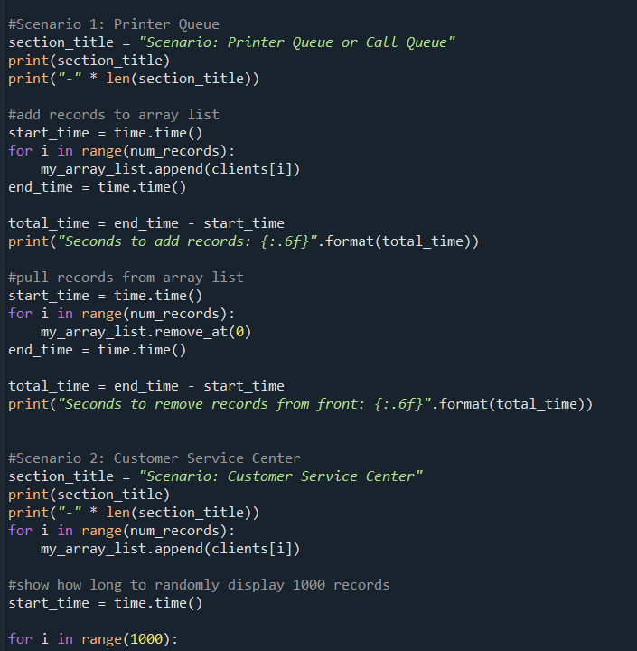
Python Code – Sorted Arrays

Slide 5
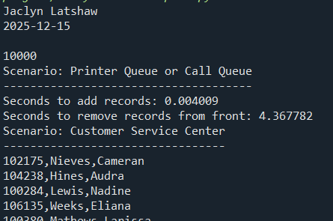
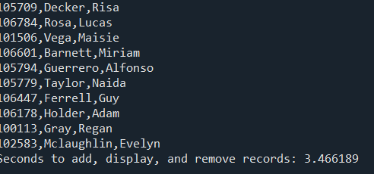
Python Code Output – Sorted Arrays
This shows that each scenario was timed as evident in the code from the previous slide. The records and the times were displayed.

Slide 6
Sorted vs. Unsorted Array Runtimes
In each scenario, both sorted and unsorted array lists were evaluated to explore whether sorting influenced performance. The first scenario involved adding and removing records, the second focused on displaying random records, and the third combined both operations. While results varied across cases, the general observation was that sorted data often provided an advantage over unsorted data.

Slide 7
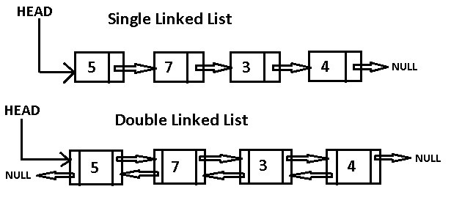
Module 2
Singly Linked List
  Each node points to the next one only
Doubly Linked List
  Each node points to both the next and previous nodes
Traversal
  Moving through the list one node at a time
  Reverse traversal – starting at the tail node
Prepend
  Adding a new node at the beginning of the list
Node
  A single element in the list, holding data and links
Head
  The first node in the list
Tail
  The last node in the list

Slide 8
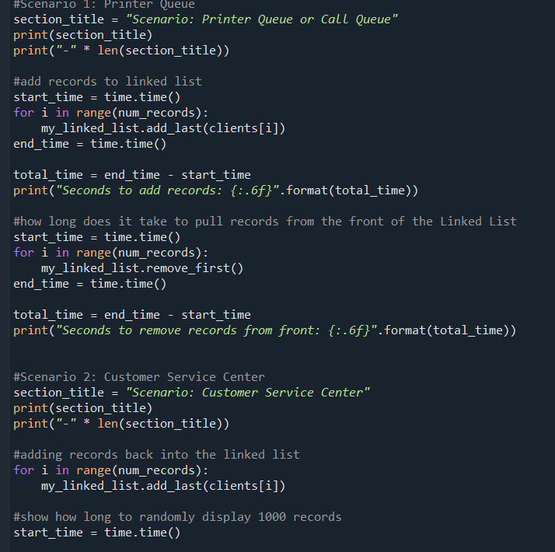
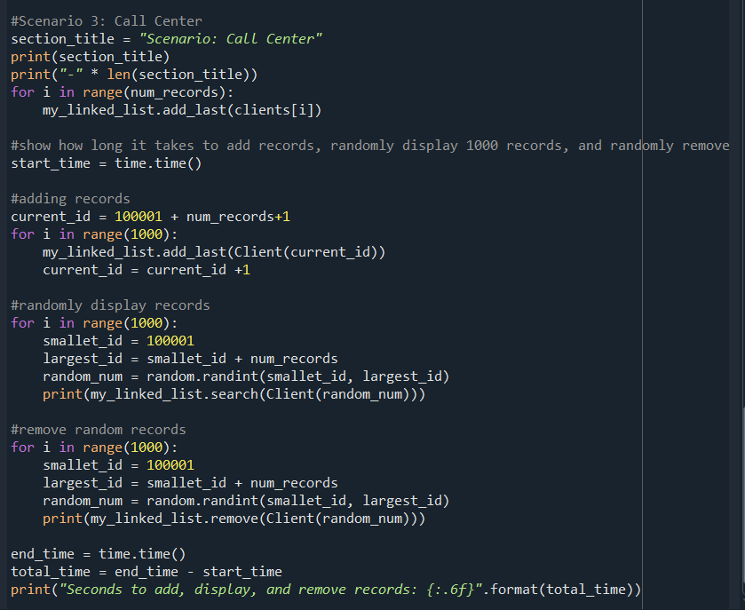
Python Code – Sorted Lists

Slide 9
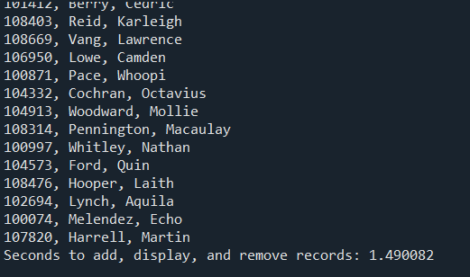
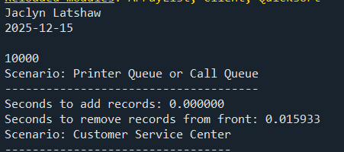
Python Code Output – Sorted Arrays
Once again, this shows that each scenario was timed as evident in the code from the previous slide. The records and the times were displayed for linked lists.

Slide 10
Arrays vs. Linked Lists
In this module, I analyzed the performance of arrays versus linked lists. I executed the same code and parameters used previously to record the timings for linked lists, then compared those results with the array data from the earlier module. The findings showed that linked lists handled record removal more efficiently, which in turn improved performance in the combined third scenario.

Slide 11
Module 3
  Stacks
    Last In First Out (LIFO)
    Like a stack of books – you pull from the top
    Push
      Insert an item at the top
    Pop
      Removes and returns an item at the top
  Queues
    First In First Out (FIFO)
    Like a waiting in line – the first customer is served and leaves
    Enqueuing
      Insert an item at the end
    Dequeuing
      Removes and returns an item at the front

Slide 12
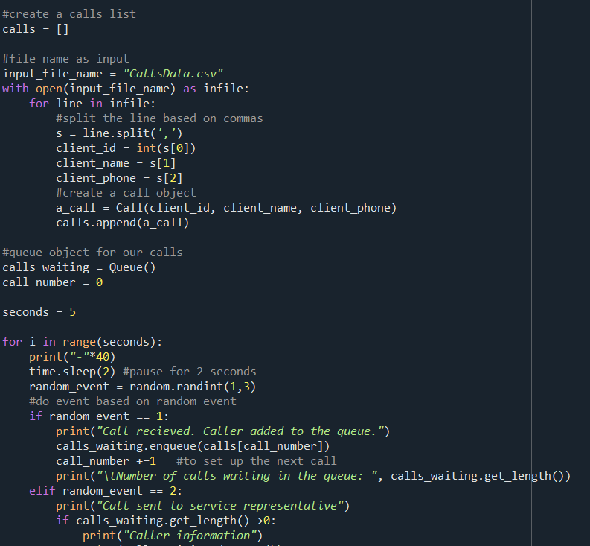
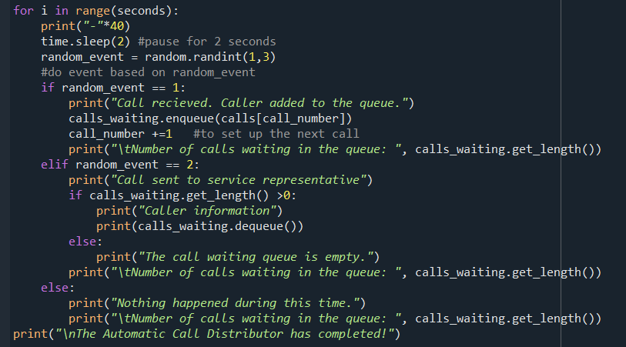
Python Code – Queues

Slide 13
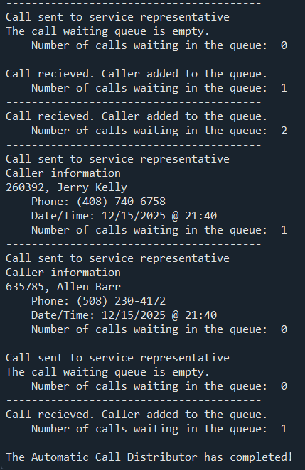
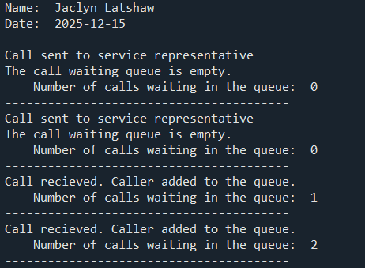
Python Code Output – Call Queue
This project functioned like a call center phone queue. Calls were simulated to come through randomly, added to the call queue, and popped off by being sent to a service representative.
Speeds were not calculated in this module.

Slide 14
Module 4
  Recursive functions – calls upon itself
  Sort Methods
    Bubble Sort
      Compares each number individually
    Insertion Sort
      Assumes the first part of the list is sorted, shifts larger numbers to the right until current number can be placed
    Selection Sort
      Similar to insertion sort, sorting method where you repeatedly find the smallest number in the unsorted part of a list and move it to the front
    Quicksort
      Uses a random pivot point to break down a list into smaller parts to sort the numbers
        Smaller items to the left, larger to the right
    Merge Sort
      Similar to quick sort, splits list in half repeatedly and then merges the lists back together
      Sort is done at the merge level
    Shell Sort
      A sorting method that starts by comparing elements far apart, then reduces the gap step by step until the list is fully sorted.

Slide 15
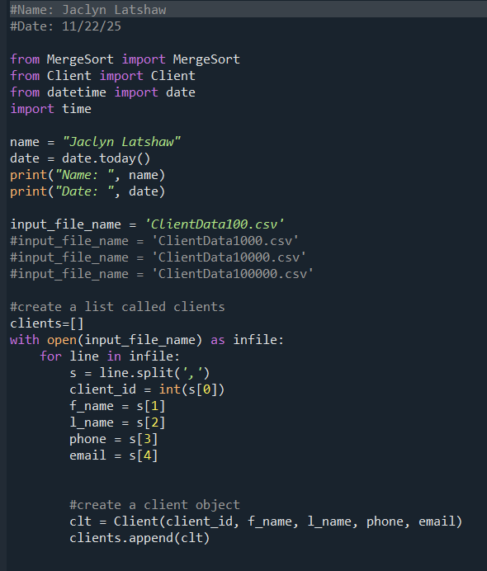
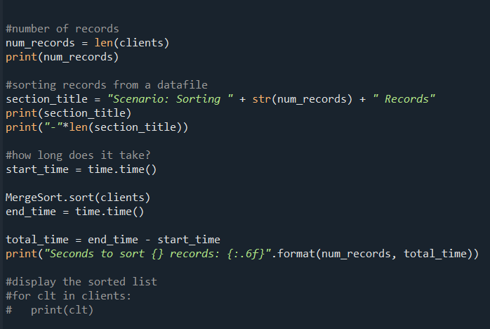
Python Code – Sort Method Comparison

Slide 16
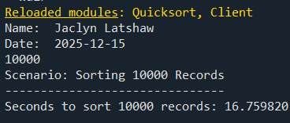
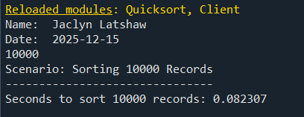
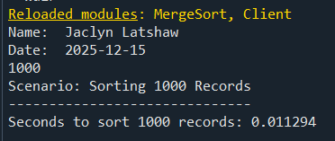
Python Code Output – Sort Method Comparison
This shows how each method performed at various record sizes. Each method was timed at each record size to measure performance.

Slide 17
Sorting Methods Comparison
I tested each sorting method across varying record sizes to compare performance. Bubble, Selection, and Insertion sorts struggled with larger datasets, while Shell, Quick, and Merge sorts managed them efficiently.

Slide 18
Module 5
Searching
  Linear – sequential searching through each element until the key is found
  Binary – finds the middle position and compares the value to the one being searched for
Hashing
  A process that converts data into a fixed‑length code for fast lookup or verification.
    Open addressing – elements stored in an array
    Separate chaining – stored in a linked list

Slide 19
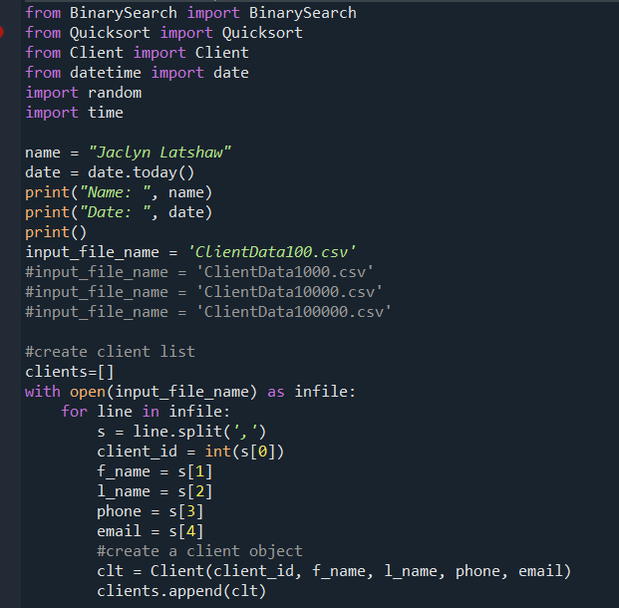
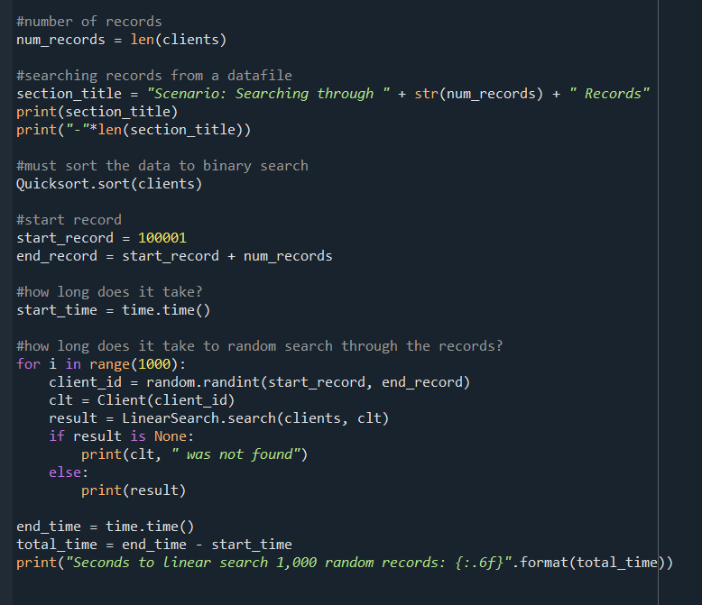
Python Code – Linear/Binary Search

Slide 20
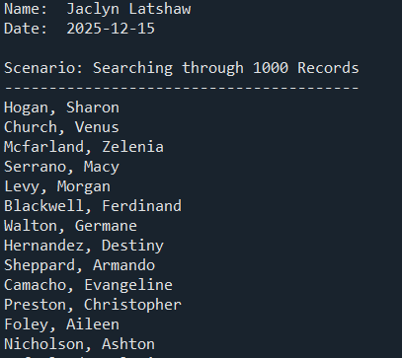
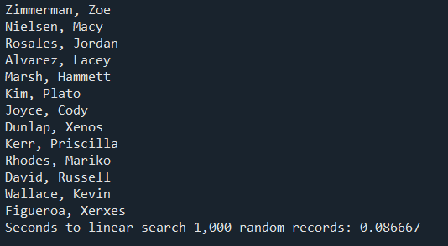
Python Code Output – Linear vs Binary
This shows results from search methods that were timed as evident in the code from the previous slide. The records and the times were displayed.

Slide 21
Linear vs Binary Search
The records were first sorted with Quicksort before applying the search methods. Binary Search proved to be the clear winner across all tests, while Linear Search performed reasonably well but becomes less effective with larger datasets.

Slide 22
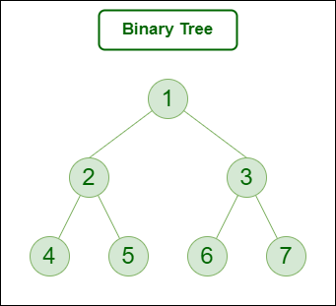
Module 6
Binary Tree – A hierarchical structure where each node has up to two children
Root – The top node of the tree
Leaf – A node with no children
Height – The length of the longest path from the root down to a leaf
Depth – The distance from the root to a given node
Subtree – A smaller tree formed from a node and its descendants
Binary Search Tree (BST) – A Binary Tree that keeps data sorted
  left child < parent < right child
Traversal – Ways to visit nodes
  Inorder – Left → Root → Right (gives sorted order in a BST)
  Preorder – Root → Left → Right (useful for copying the tree)
  Postorder – Left → Right → Root (useful for deleting the tree)

Slide 23
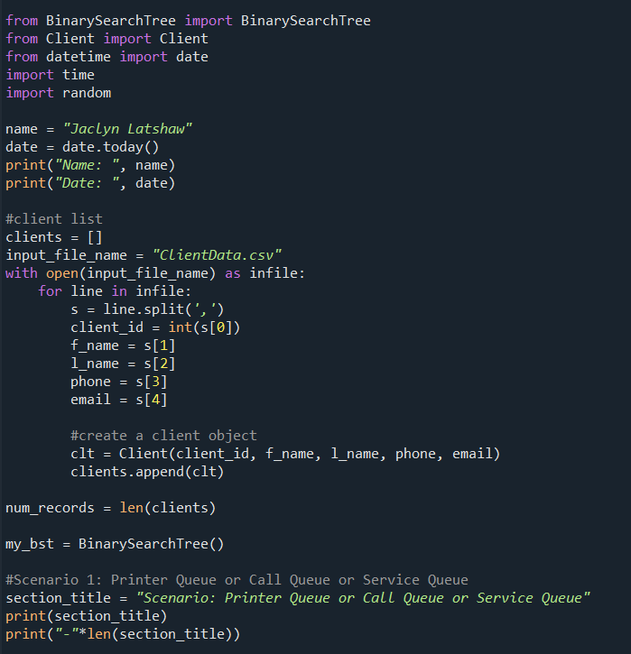
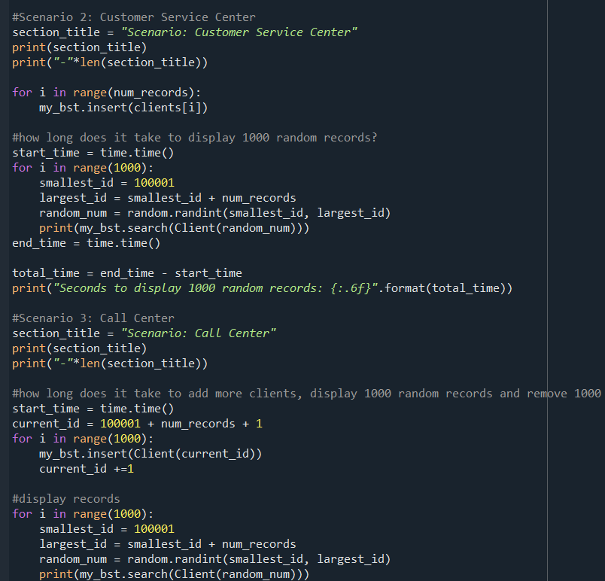
Python Code – Binary Search Tree

Slide 24
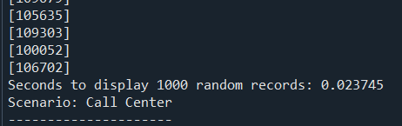
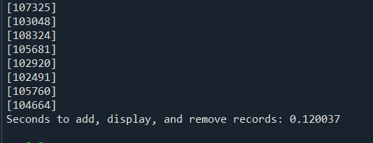
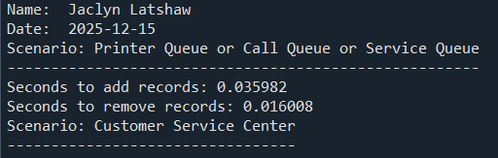
Python Code Output – Binary Search Tree
This shows that each scenario was timed as evident in the code from the previous slide. The records and the times are displayed. Previous times for arrays and linked lists were taken from previous modules.

Slide 25
Arrays, Linked Lists, & BST Comparison
Revisiting my original speed test, I included the Binary Search Tree alongside arrays and linked lists for comparison. The BST consistently outperformed the other structures, demonstrating its efficiency in handling search operations. This highlights how tree‑based organization can provide a significant advantage over linear data structures.

Slide 26

Module 7
Graphs
  Undirected graph – Connections go both ways
  Directed graph – One‑way connections
  Weight – A value on an edge, such as cost or distance
  Path – A sequence of edges connecting nodes
  Simple path – A path without repeating nodes
  Cycle – A path that starts and ends at the same node
Graph representations
  Adjacency list - each node lists its connections
  Adjacency matrix - a grid showing if nodes are connected
Real World Example: Bus/Train Routes

Slide 27
Final Analysis
Progression of Structures – The course moved from linear (arrays, linked lists) to hierarchical (trees) to networked (graphs), showing how complexity builds step by step.
Performance Insights – Comparisons revealed that advanced methods consistently outperform simpler approaches, especially with larger datasets.
Practical Applications – These concepts extend beyond theory, offering relevance in real‑world computing and problem‑solving across diverse domains.
Key Lesson – Choosing the right data structure is critical; efficiency depends not only on the algorithm but also on how data is organized.

Slide 28
Challenges
Visualizing Concepts – Some structures and algorithms were difficult to picture mentally, especially when thinking through traversals and relationships.
  Cognitive Load – Following the flow of operations in my head was challenging without a clear visual aid.
  Problem‑Solving Strategy – To overcome this, I often had to write things down step by step, which helped me organize and understand the processes more effectively.

Slide 29
Career Skills
Problem‑solving – Figuring out the best way to tackle different challenges.
Efficiency awareness – Knowing how to compare options and pick the faster, smarter solution.
Clear communication – Explaining tricky concepts in a way that makes sense to others.
Adaptability – Switching between different structures and approaches depending on what the situation calls for.
Real‑world connection – Seeing how these ideas apply outside the classroom and in everyday computing tasks.
Python Coding

Slide 30
Conclusion
Through this project, I explored the progression of data structures and algorithms from arrays and linked lists to stacks, queues, sorting methods, searching techniques, binary trees, and graphs. Each module demonstrated how structure and organization directly influence efficiency, scalability, and problem‑solving. Performance comparisons showed that advanced structures such as Binary Search Trees and efficient sorting methods consistently outperformed simpler approaches, highlighting the importance of choosing the right tool for the task. Overall, this journey emphasized not only the theoretical foundations of computer science but also their practical applications in real‑world scenarios, preparing me to apply these concepts in both academic and professional settings.

Slide 31
References
GeeksforGeeks. (2025, October 18). Types of trees. GeeksforGeeks. https://www.geeksforgeeks.org/dsa/types-of-trees-in-data-structures/
IT위키. (n.d.). https://itwiki.kr/w/%EC%97%B0%EA%B2%B0_%EB%A6%AC%EC%8A%A4%ED%8A%B8#google_vignette

