Slide 1
CEIS 114
Final Project
Jaclyn Latshaw
July 2024
Creating a Multiple Traffic Light Controller with a Cross Walk and an Emergency Buzzer with secured IoT Control via Web

Slide 2
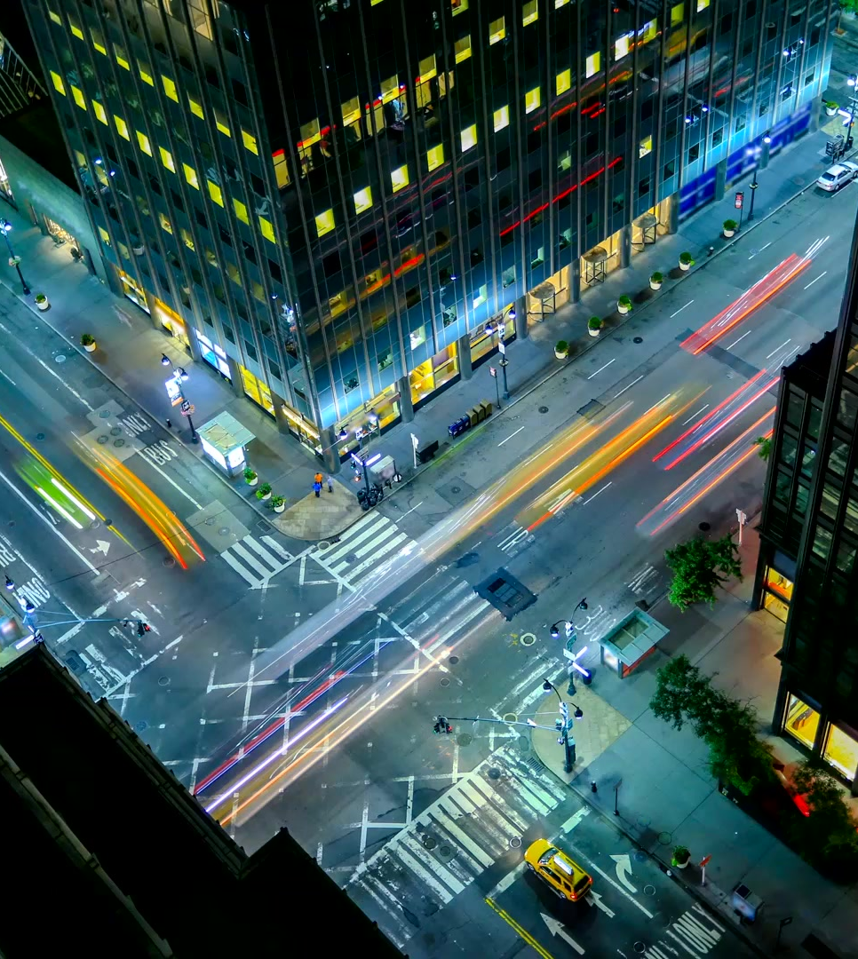
Introduction
The world is constantly changing and adapting to technological advancements. Staying ahead of the curve allows us to better understand how everyday objects can be improved through technology.
Traffic lights allow the flow of traffic to pass through intersections and can even be controlled to allow pedestrians to safely cross streets. They can also be controlled to allow emergency vehicles to quickly get to their destinations.
Over several weeks, I designed an IoT traffic system that has a controller for the cross walk and emergency buzzer that can be controlled over the internet.

Slide 3
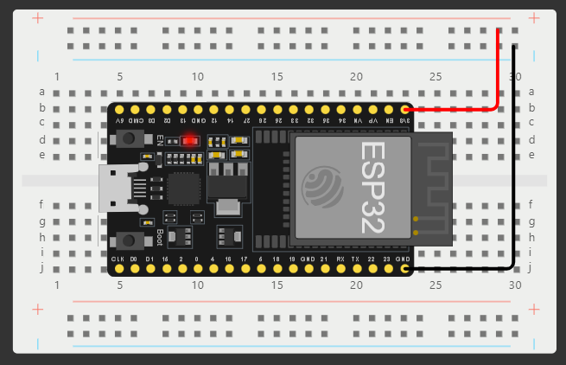
ESP32 Board
The first step to building this device is to select a controller and connect it to the breadboard. I selected an ESP32 controller to be used as my microcontroller. This will act as the hub for all the other components that will be added throughout the project.
The positive (red) and negative (black) wires are connected to the microcontroller and the breadboard. This will allow power between the two objects that will be passed to the other components.

Slide 4
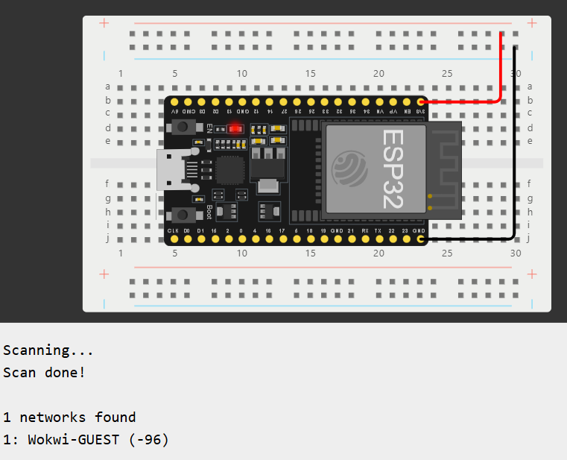
ESP32 WiFi Scan
The next step was to setup the ESP32 board to act as a gateway to an IP network. Here it is connected to the Wokwi-Guest network. Now, it should be able to transfer data from sensors and trigger other components to activate.

Slide 5
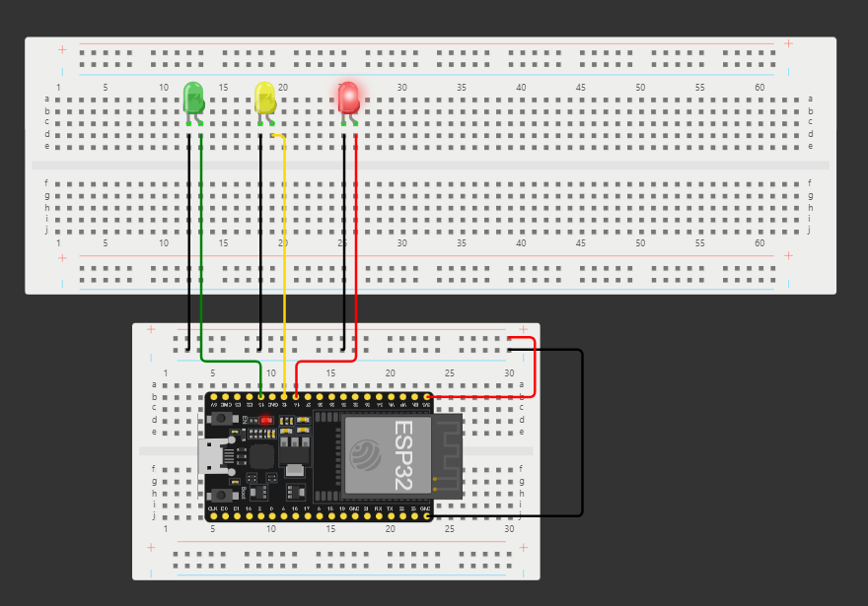
The First Traffic Light System
Now, it was time to introduce the first set of traffic lights. Three LED lights were added to a larger breadboard. Wires were attached to the microcontroller and breadboard. This allows the microcontroller to communicate and send signals to activate the LED’s while also giving power to allow them to work. The lights were then coded to allow them to alternate like an actual traffic light would do.

Slide 6
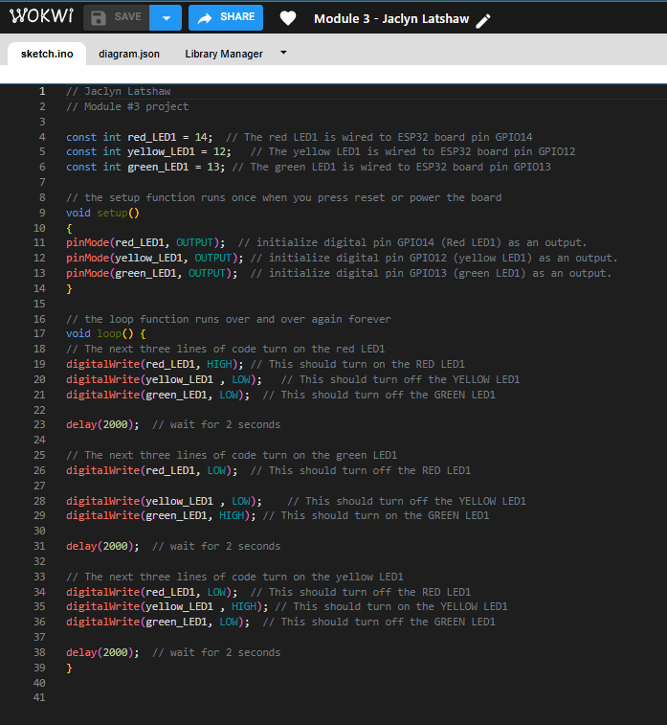
The Initial Code
Here is a screenshot of the code used for the initial traffic light system. Again, this allows the LED’s to alternate similar to a traffic light. This code is passed to the microcontroller which uses the code to send signals to the LED’s to light up at certain times. The code also allows the user to control the intensity of the lights, high or low.

Slide 7
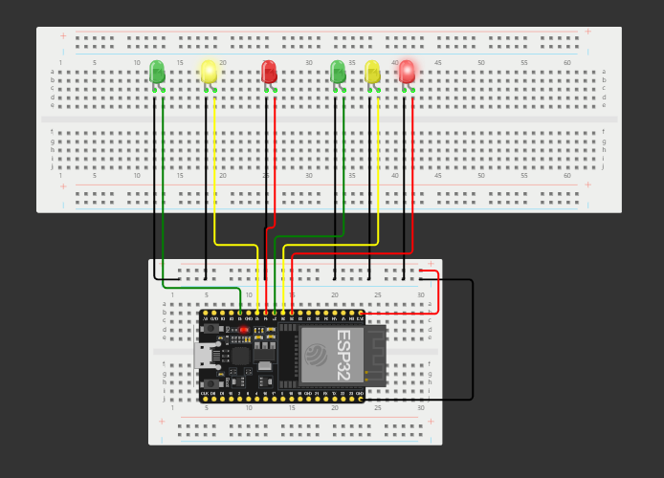
The Second Set of Traffic Lights
An intersection is not very useful without a second set of traffic lights to let the other side of traffic know when to proceed or to stop.
A second set was added to the board to simulate a real intersection. These lights were then coded to work with the first set. Once again, everything is controlled via the ESP32 controller.

Slide 8
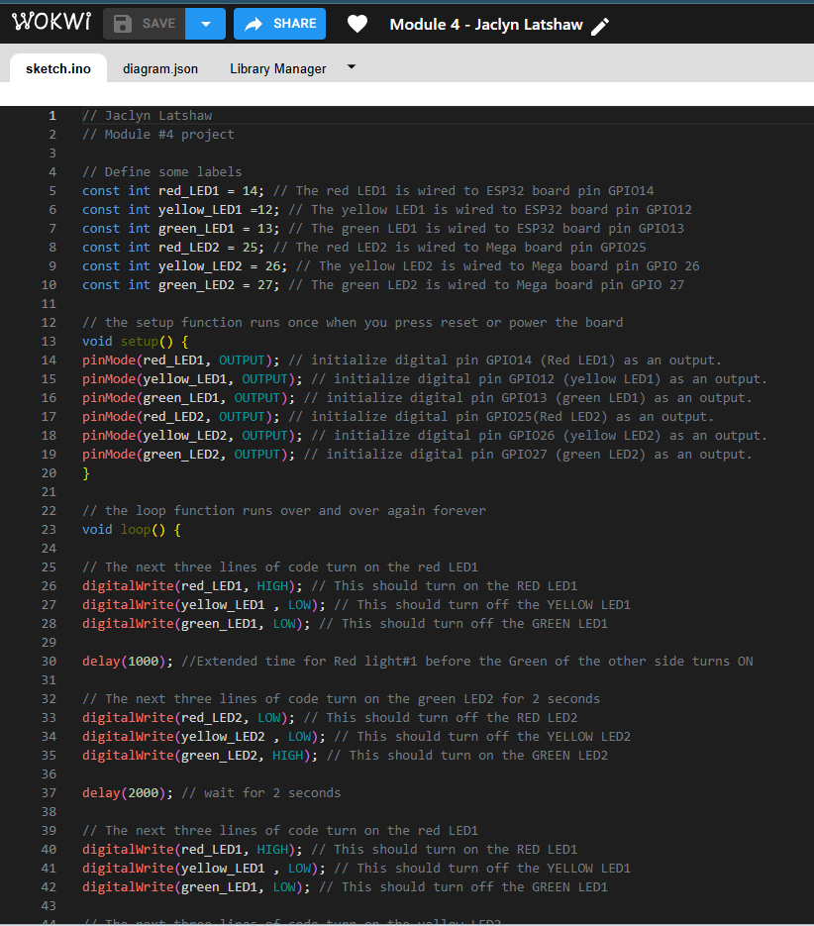
Updated Code
Here is the screenshot of some of the code that was updated to allow the traffic lights to function. The code will act as instructions that will allow one set of lights to cycle while the other set will remain on the red LED. As soon as the cycle is complete, the first group will remain on the red LED while the second group will begin cycling through.

Slide 9
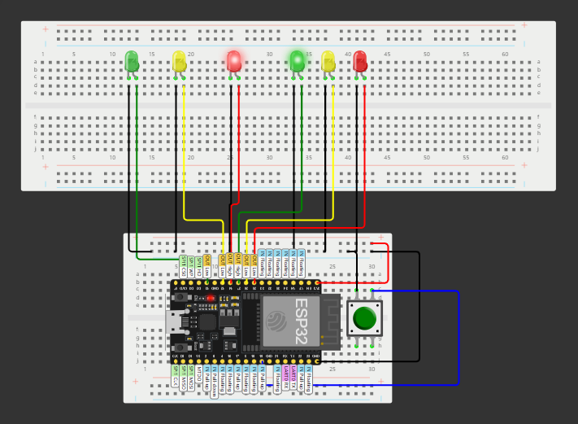
Adding a Push Button – Cross Walk
The next step was to add a push button. This is the beginning of adding the pedestrian cross walk function to the traffic system. Once pressed, a signal will be sent back to the microcontroller to finish the current cycle and place both sets of lights to remain on red.

Slide 10
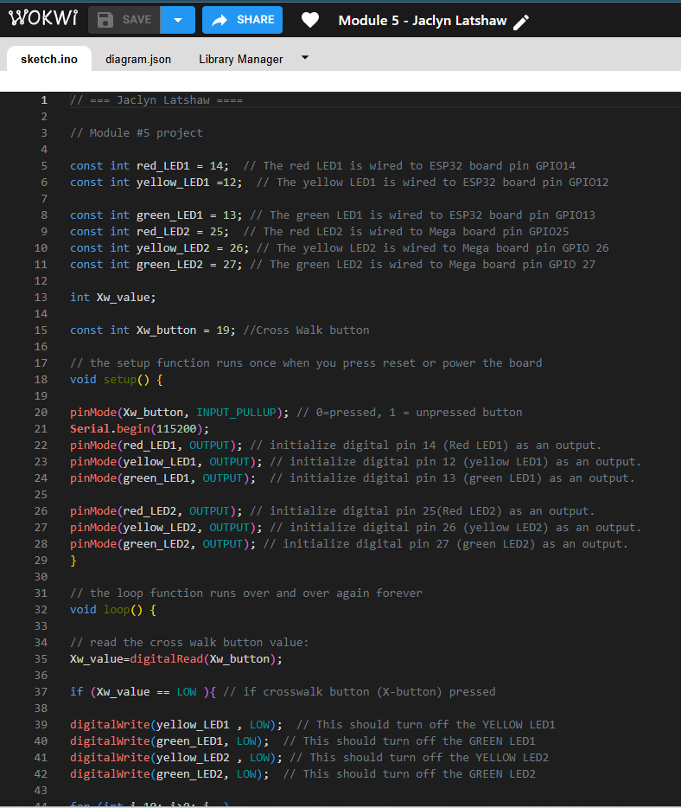
Updated Code
The code has been updated once more to allow the push button to communicate with the microcontroller. This also adds the crosswalk countdown.
Most modern crosswalks include a countdown so pedestrians can determine if it is still safe to cross by displaying the amount of time left in seconds.

Slide 11
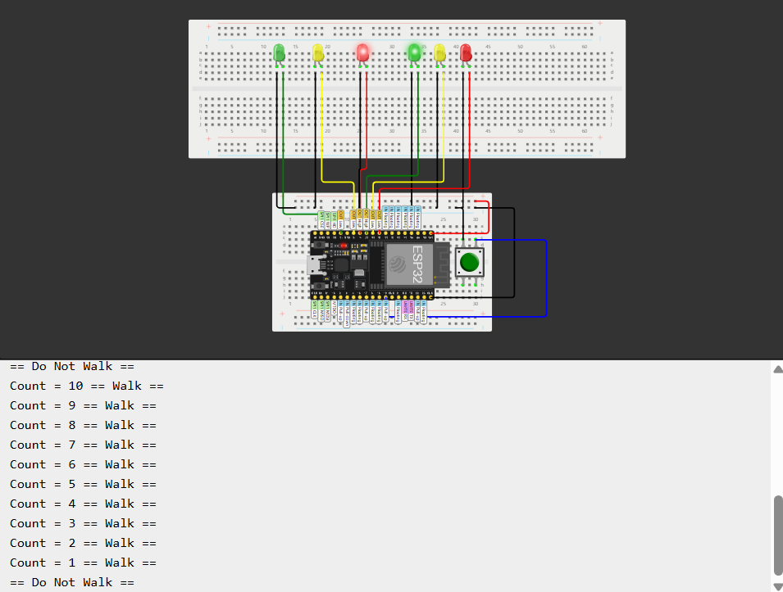
Serial Monitor Display
This is the serial monitor of the system. This displays information relating to what is occurring in the system. The countdown for the push button is displayed here. When the countdown is complete, it displays the message “Do Not Walk”.

Slide 12
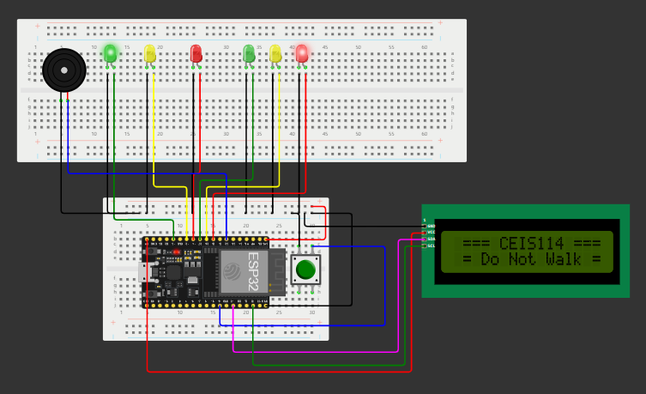
Adding an LCD Display
The next logical step would be to add a display to the system so the pedestrian can actually see the countdown. The information that was previously displayed in the serial monitor will now be displayed on the LCD screen.
I have also added a buzzer that will also notify the surrounding area that there is a change going on in the environment that needs attention. This buzzer will play a bigger role in the future.

Slide 13
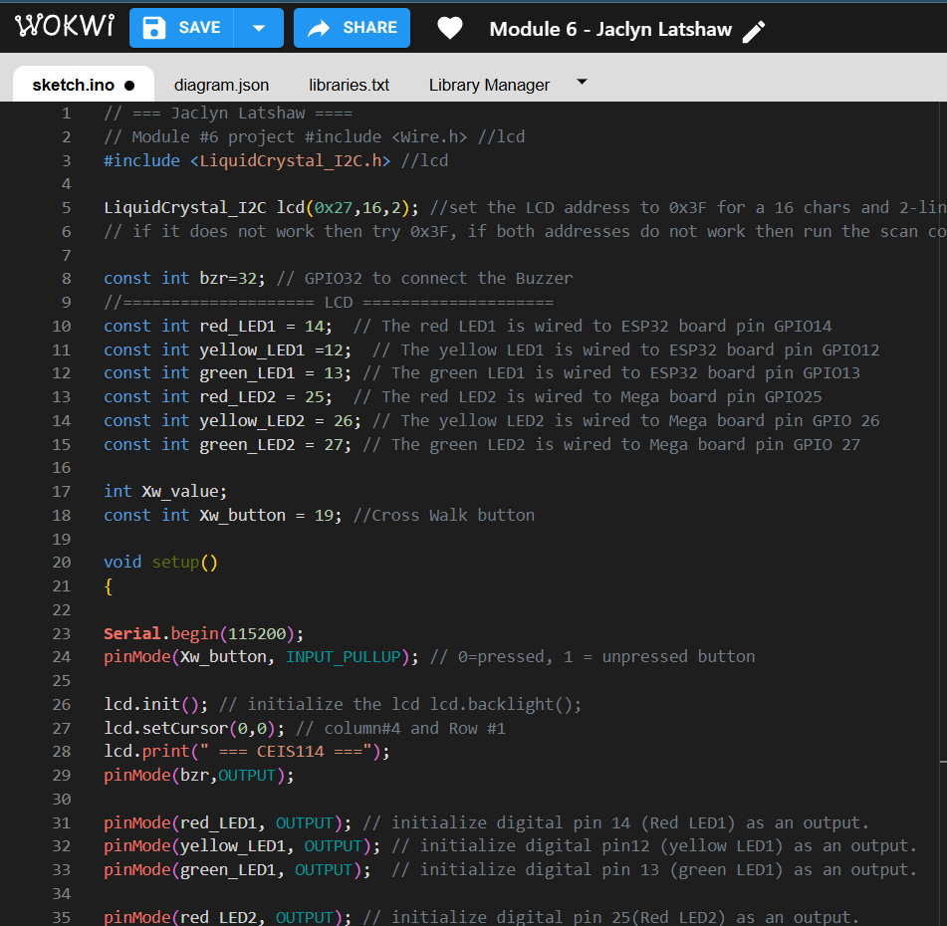
Updated Code
Once more, I have updated the code to reflect the changes I made in my system.

Slide 14
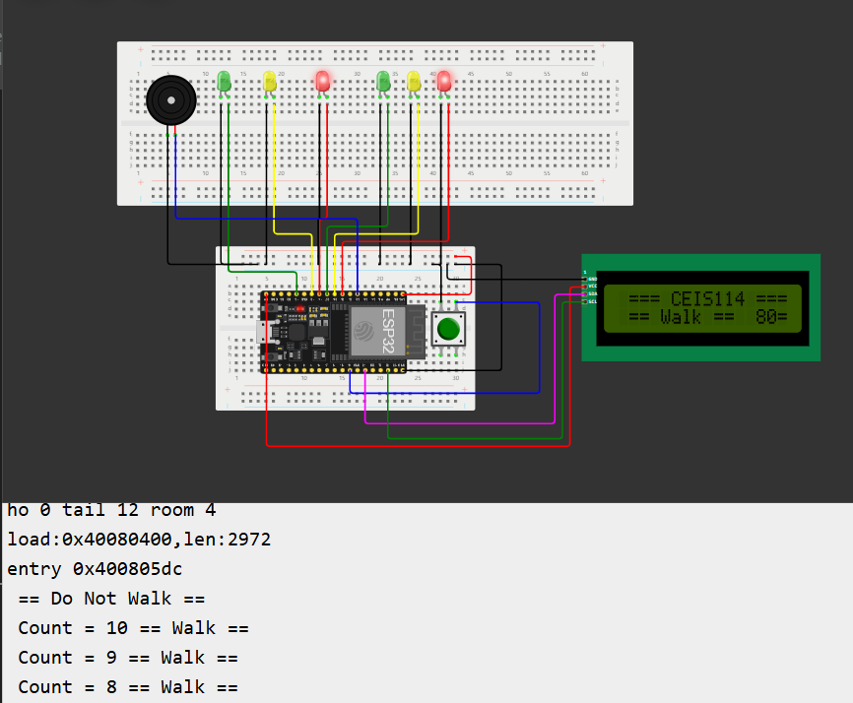
Serial Monitor with LCD Display
Here it is shown that the messages regarding the crosswalk function can be viewed on the serial monitor and the LCD display.

Slide 15
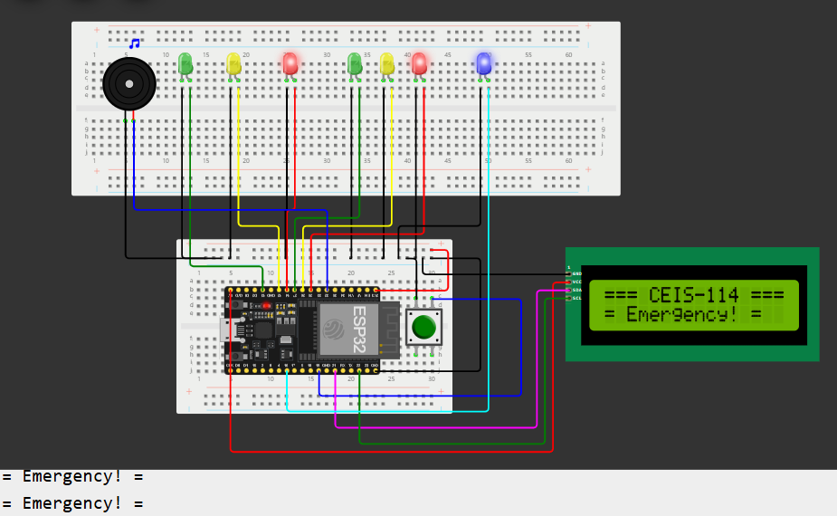
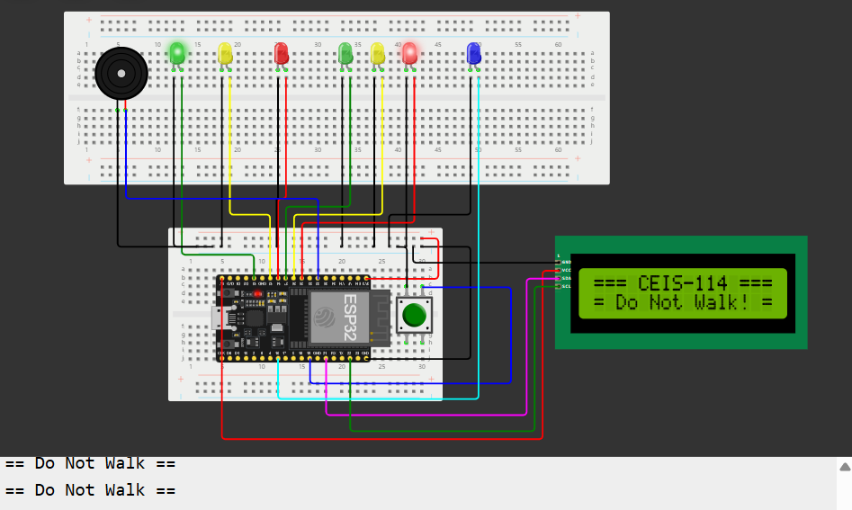
Emergency Light Function
It is very common for emergency vehicles to have a device that they can use to quickly change traffic lights to allow them to pass though without waiting. This has allowed faster response times in moments where every second is critical.
A blue LED has been added to alert vehicles and pedestrians that an emergency vehicle is approaching. The LCD display also reflects this change. The buzzer will now also activate to alert everyone in the area.

Slide 16
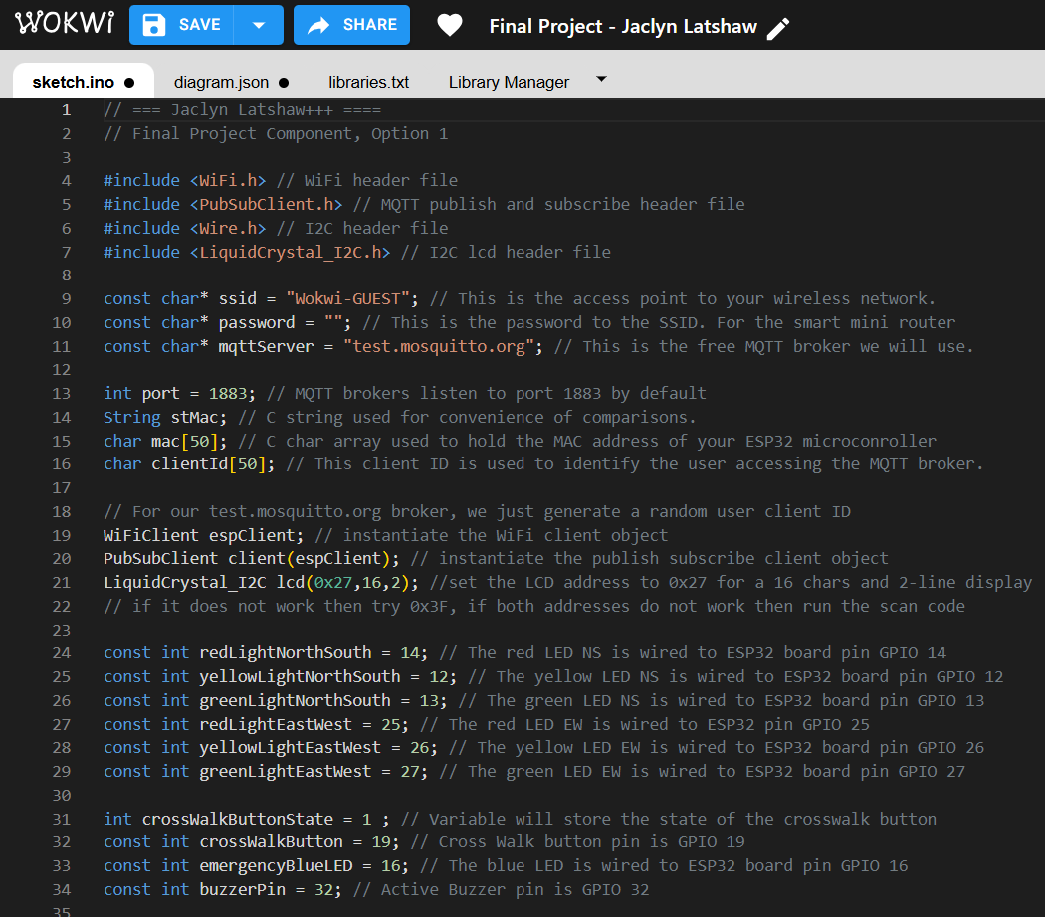
Updated Code
Again, the code has been updated to include the changes made. This allows the buzzer to activate, the blue LED to blink, and the LCD display to warn of the approaching emergency vehicle.

Slide 17
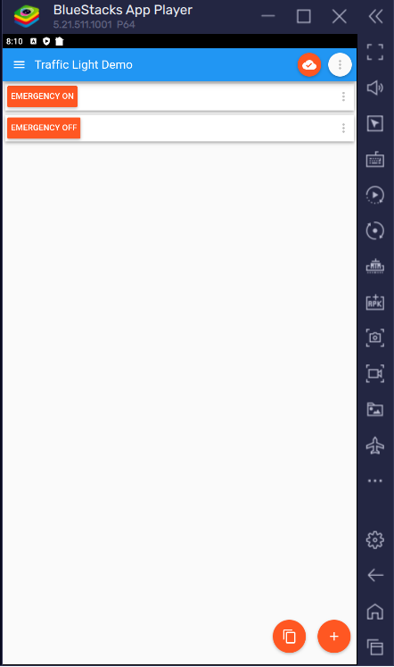
Remote Control of Traffic System via WiFi
As discussed previously, emergency vehicles need to be able to have access to the alert system. We also would not want just anybody activating this function. Through an MQTT panel, I was able to create a special button that allows the emergency alert to activate in this traffic system.

Slide 18
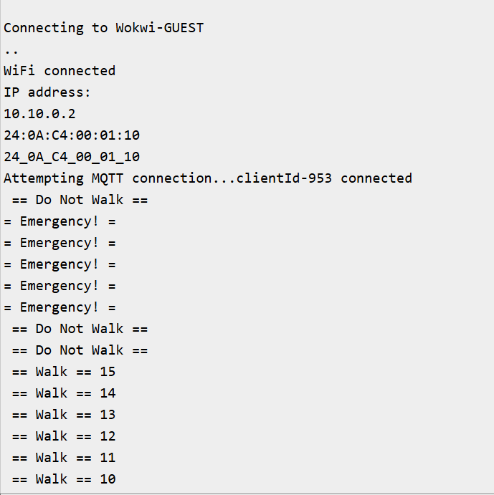
Serial Monitor of Emergency Alert
Here is the Serial Monitor of the traffic system that shows the connection to MQTT panel. This panel allows the emergency alert to activate in the traffic system via WiFi.

Slide 19
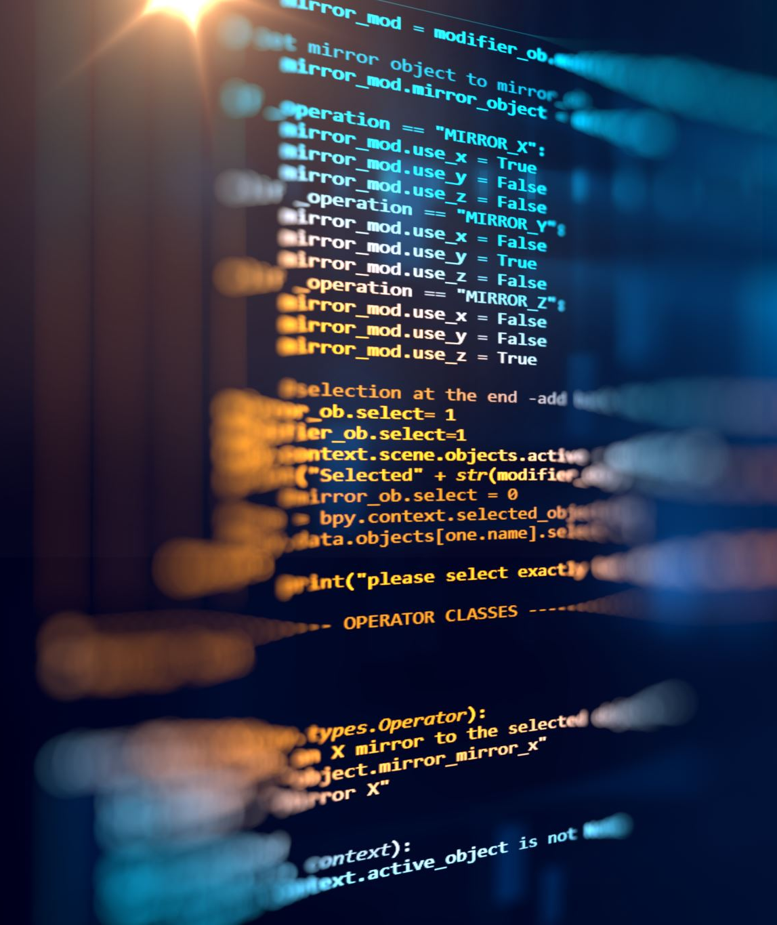
Challenges
I have previously never designed a system where I was asked to add a WiFi controlled aspect to the system. I was given instructions on how to setup the connection for some of the fields that required information, but I was confused as to why it was not connecting properly. I realized they provided a screenshot that displayed all the information needed for each field.
My time management skills were tested toward the end of the project as I had encountered a slight emergency at home that required my attention. I was able to handle the emergency and find time to complete the final portion of the project in time.

Slide 20
Career Skills
Time Management and Project Planning
Wokwi Simulator
WiFi Controlled Button Experience – MQTT Panel

Slide 21
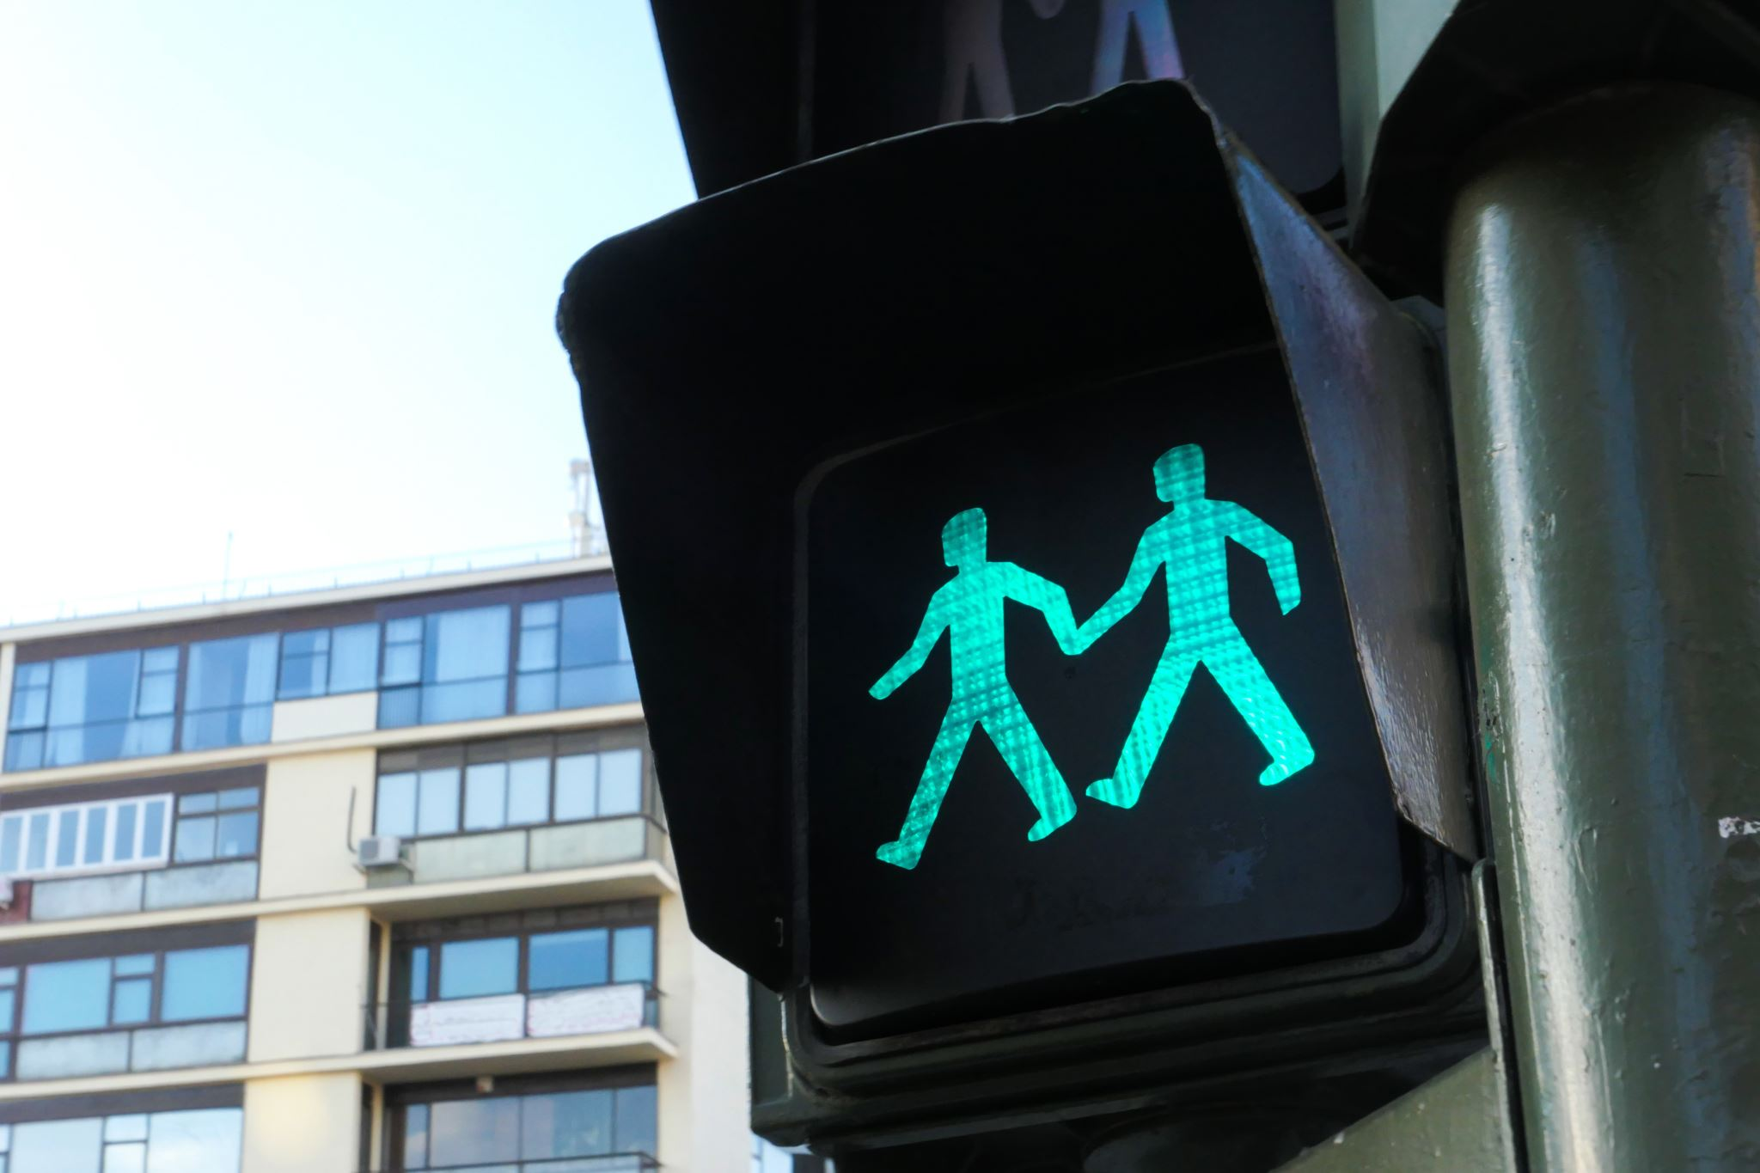
Conclusion
I have gained an appreciation for developers improving simple everyday items such as the traffic light. This allows communities to improve their roadways and allow safer travels for all community members whether on foot or by car.
This project has allowed me to really start looking at how I can improve the world around me and make tasks easier for everyone.

Slide 22
References
Wokwi.com
Devry University

