Slide 1
CEIS106
Linux Operating System
Jaclyn Latshaw
May 2024

Slide 2
Introduction

Slide 3
What is Linux?

Slide 4
Linux Filesystem Tree

Slide 5
Navigate the Linux filesystem tree
1. What is the pwd command an acronym for? What about the cd command?
Answer here:
PWD stands for Print Working Directory, and it is the command used to display the current directory in the directory tree.
CD, change directory, command is used to change the current directory in the directory tree.
2. Explain the differences between a relative path and an absolute/full path in Linux.
Answer here:
An absolute path is the full pathname from the root directory to a file or directory. The relative path is a pathname that is in relation to the current directory in the tree and does not show the full path from the root.
References:
1. MindTap course, Linux+ and LPIC-1 Guide to Linux Certification, Fifth Edition, Chapter 3

Slide 6
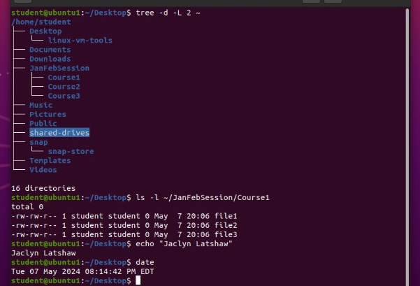
Create directories and files
Take a screenshot of the output in Steps 5 and 6.

Slide 7
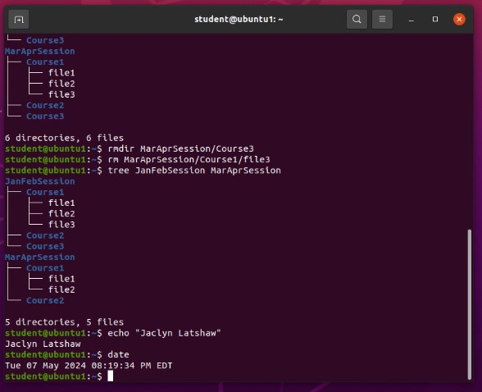
Copy and remove directories and files
Take a screenshot of the output in Step 3.

Slide 8
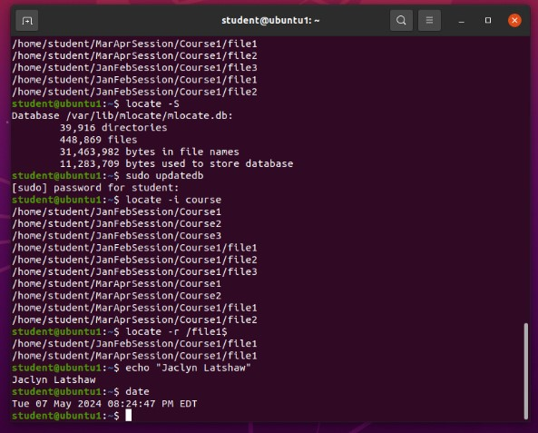
Locate directories and files
Take a screenshot of the output in Steps 5 and 6.

Slide 9
Types of Permissions

Slide 10
Variables & Metacharacters

Slide 11
Create a shell script
1. What are the file permissions of the script?
Answer here:
The default permissions of the script are “-rw-rw-r--” which means that the user and group have read and write permissions. Other only has read permissions. No one has execute permissions.
2. What’s the name of the user-defined variable in the script?
Answer here:
The user-defined variable is “$text” and tells the script that the user input is what should be filled in whenever the script encounters this variable.
3. Which redirection meta-character is used in the script? What does it do?
Answer here:
The meta-character used for redirection is “>>”. This allows redirection that prevents the file from being cleared by the BASH shell and appends the output to the existing output.
References:
1. Mindtap - Cengage

Slide 12
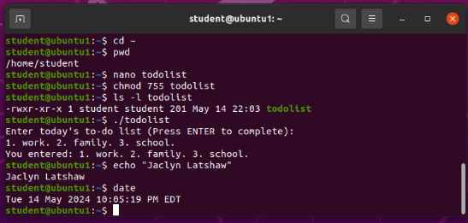
Change script file permissions
Take a screenshot of the output in Step 5.

Slide 13
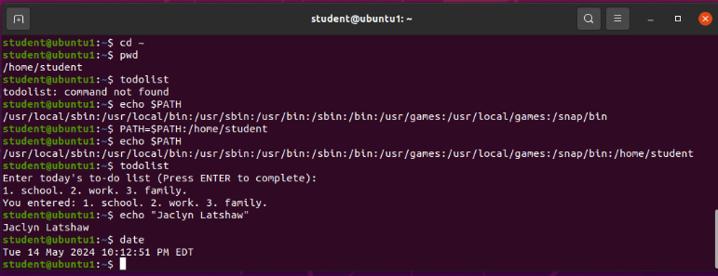
Set the PATH variable
Take a screenshot of the output in Step 6.

Slide 14
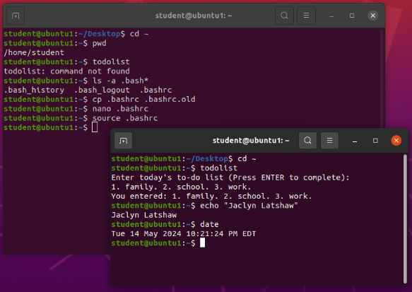
Make the PATH variable permanent
Run the todolist script before and after making the PATH variable permanent. Take a screenshot of both Terminal windows.

Slide 15
Adding Users

Slide 16
Adding Groups

Slide 17

Add users and groups in CLI
1. What does the –m option in the useradd command do?
Answer here: This option specifies a home directory to be created for the user being added.
2. What does the -3 option in the tail command do?
Answer here: The tail command prints the last lines of a file. With the “-3” option, this is telling the command to print the last 3 lines of the file.
3. Which line of the /etc/group file lists members of the “students” group? Copy it here.
Answer here:
References:
1. MindTap - Cengage
2. Live Lecture

Slide 18
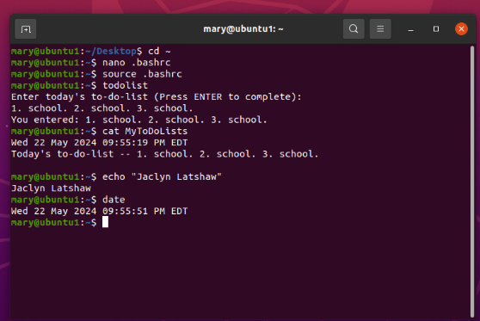
Test user and group settings
Take a screenshot of the output in Step 6.

Slide 19
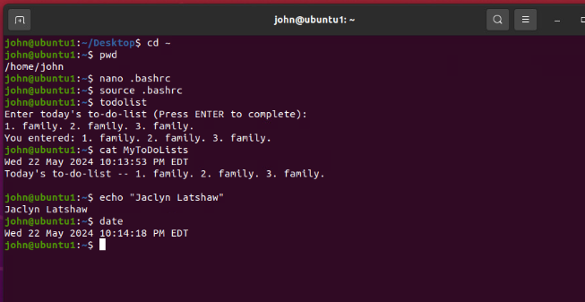
Add users in GUI
Take a screenshot of the output in Step 9.

Slide 20
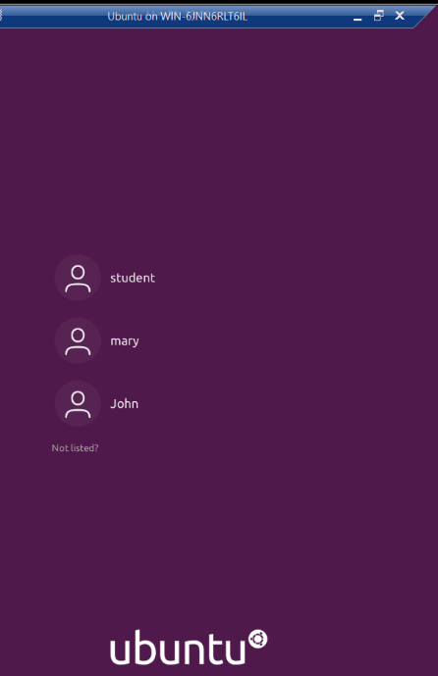
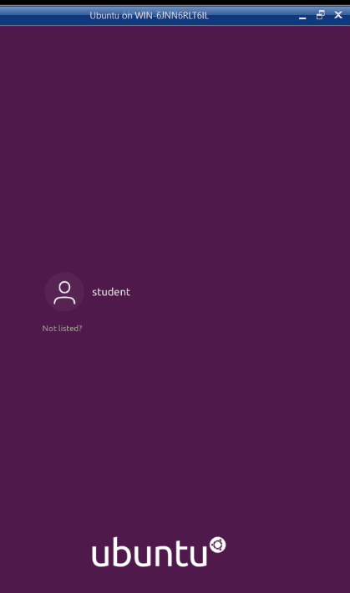

Remove users and groups
Take a screenshot of the log on page with three user accounts.
Take a screenshot of the log on page with only your user account (i.e., student).

Slide 21
Networks

Slide 22
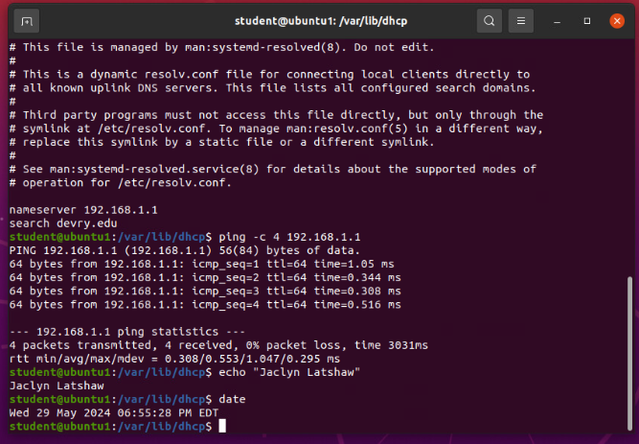
Discover host IP configurations
1. What is the IP address of your Ubuntu machine?
Answer here: 192.168.1.107
2. What is the IP address of its default gateway?
Answer here: 192.168.1.1
3. What is the IP address of its DHCP server?
Answer here: 192.168.1.1
4. What is the IP address of its DNS server?
Answer here: 192.168.1.1
Take a screen capture of the output in Step 12.

Slide 23
Manage network interfaces
Which DHCP message is shown in the output of the sudo dhclient –v –r eth0 command?
Answer here:
DHCPRELEASE of 192.168.1.108 on eth0 to 192.168.1.1 port 67 (xid=0x1e206f9)
2. Which four DHCP messages are shown in the output of the sudo dhclient –v eth0 command?
Answer here:
DHCPDISCOVER on eth0 to 255.255.255.255 port 67 interval 3 (xid=0x487fdc03)
DHCPOFFER of 192.168.1.108 from 192.168.1.1
DHCPREQUEST for 192.168.1.108 from 192.168.1.1 (xid=0x3dc7f48)
DHCPACK of 192.168.1.108 from 192.168.1.1 (xid=0x487fdc03)

Slide 24
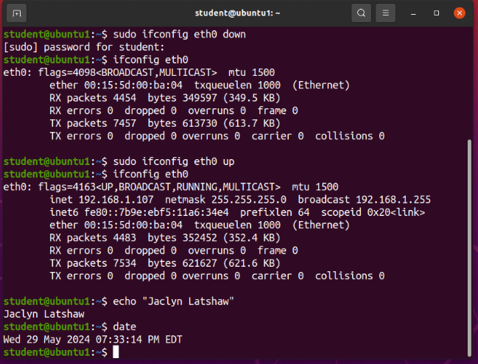
Use network utilities
Take a screen capture of the output in Step 7 and Step 8.

Slide 25
Monitor Linux processes
1. What is the default action of the 15 SIGTERM kill signal?
Answer here: It kills the process that is currently highlighted.
2. In the System Monitor window, click on % CPU to sort the processes by CPU load. Which process shows the highest percentage of CPU usage?
Answer here: The gnome-shell is using the highest percentage of CPU usage.
References:
1. Live Lecture
2. Infosec Learning Console

Slide 26
Monitor user activities
Issue the sudo accton on command to turn on GNC accounting. Run the sudo updatedb command. Enter lastcomm updatedb to check if the updatedb command was executed before. Remember to turn off GNC accounting (sudo accton off) after answering the questions.
1. What flag value is displayed in the output?
Answer here: S for superuser
2. Why is the name of the user who ran the processes shown as root, not student?
Answer here: The user used the sudo command to elevate their permissions to that of a superuser.
References:
1. Live Lecture

Slide 27
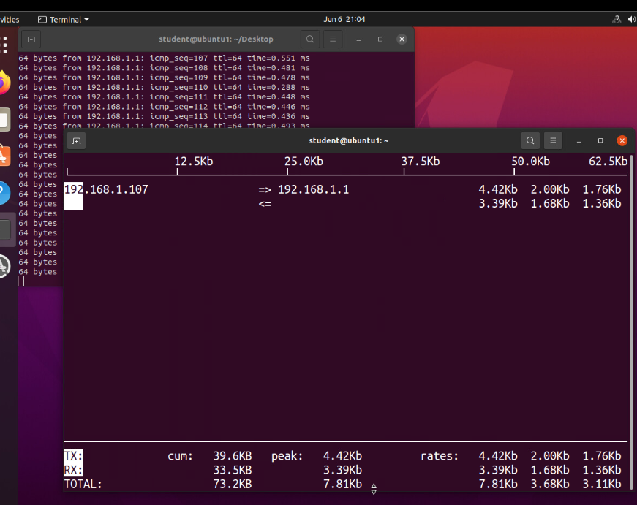
Monitor network bandwidth usage
Take a screenshot of the output in Step 4.

Slide 28
Challenges

Slide 29
Career Skills

Slide 30
Conclusion

