Slide 1

NETW191: Fundamentals of Information Technology and Networking
Final Project
Jaclyn Latshaw
September 2024

Slide 2

Introduction
Networking is integral to the Information Technology field. It is crucial to understand the fundamentals of a network including how different components operate and interact with one another. It is also important to understand how to split a network and keep it secure. With this project, I demonstrate these principals by prioritizing different objectives each week.

Slide 3
Week 1 Objectives
The first objective of this course is to apply an IPv4 addressing scheme to support the network of a Linux operating system. I used command line prompts to check the IP address of the router, change settings in the Firefox web browser, and changed the IPv4 address. In the next slides, I will show supporting evidence of these changes.

Slide 4

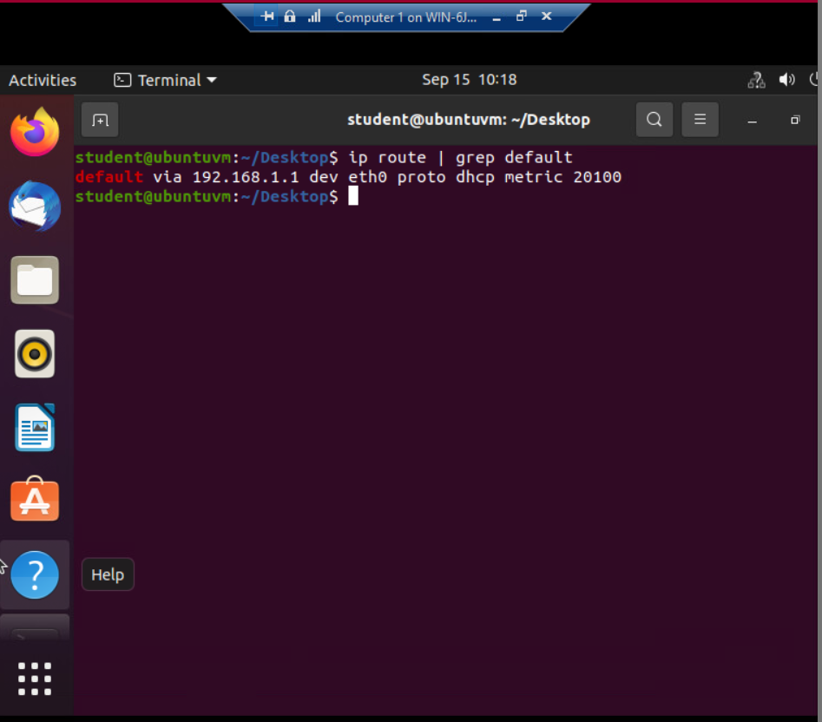
Preparation
This screenshot shows the default gateway through a Linux terminal. This defines the initial IP address of the network that I will be using throughout this project.

Slide 5
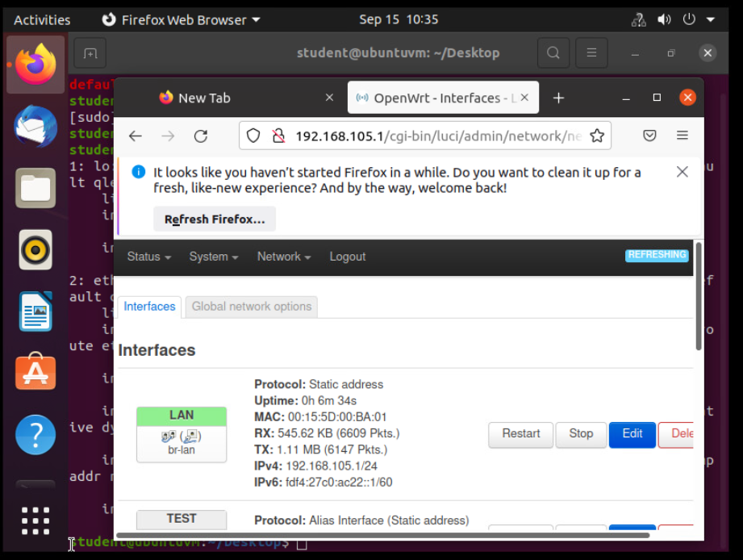
IPv4 Address Assignment
I was able to create an interface using the virtual machine that shows the new IPv4 address on the LAN interface. This establishes a static address for IP address 192.168.105.1/24 within the network that I found through the default gateway in the terminal.

Slide 6
Week 1 Takeaways
It is simple to update the IPv4 addressing scheme using the command prompt in Linux and the web browser Firefox. I needed to find the current gateway through the command prompt. Then, I changed the interface through the web browser and updated the settings to change the gateway. I used the command line prompt to reconnect the interface and tested the change in the web browser.

Slide 7
Week 2 Objectives
In the second portion of the project, I explored the IP addresses of a SOHO router and two virtual computers that were on the same network. I was able to ping the connection from each terminal to ensure that the signals were reaching the router and the other virtual machine. In the following slides, I have included screenshots of the IP addresses and the connectivity check.

Slide 8
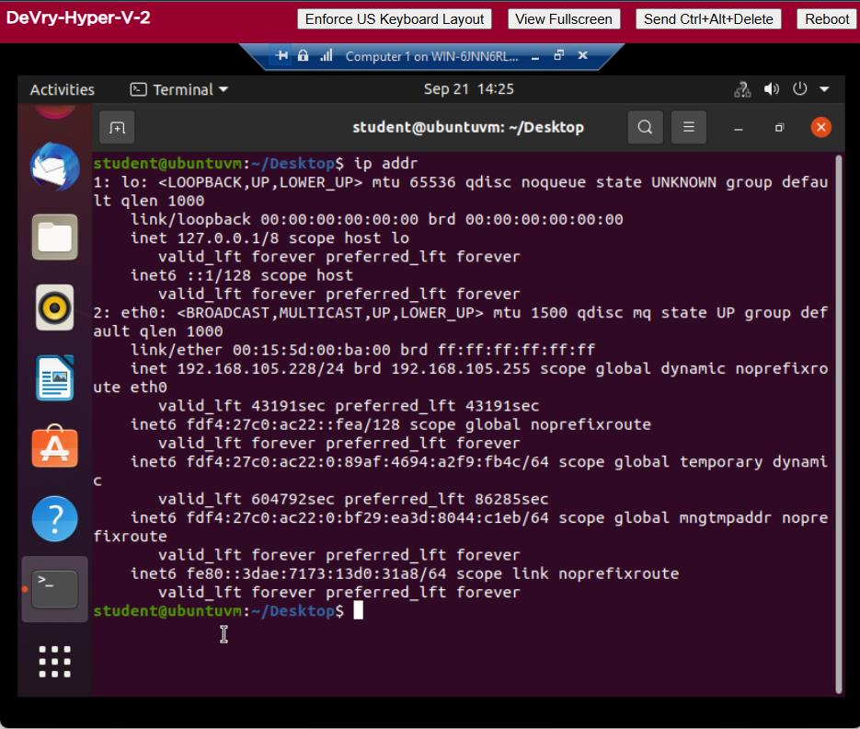
Dynamic IP Address Assignment
This is the information regarding the IPv4 IP address of the Computer 1 virtual machine. This information will be used to identify the device and run a connectivity check.

Slide 9
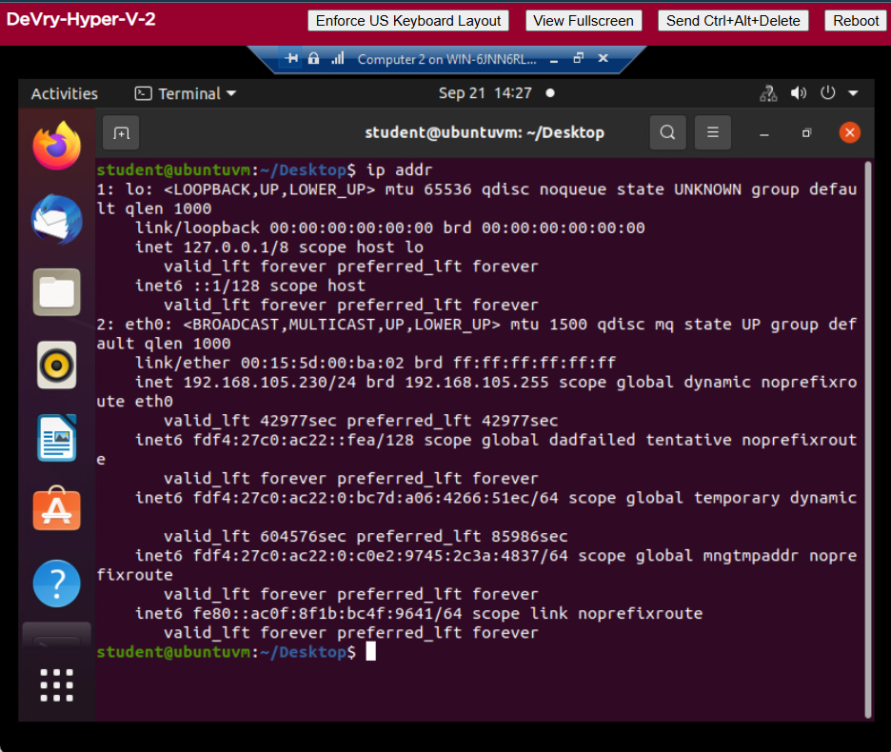
Dynamic IP Address Assignment
Just like the Computer 1 virtual machine, I needed to find and identify the IPv4 address for Computer 2.
The IP addresses from each machine also identifies that they are within the same network as the IP addresses are similar to each other as well as the default gateway.

Slide 10
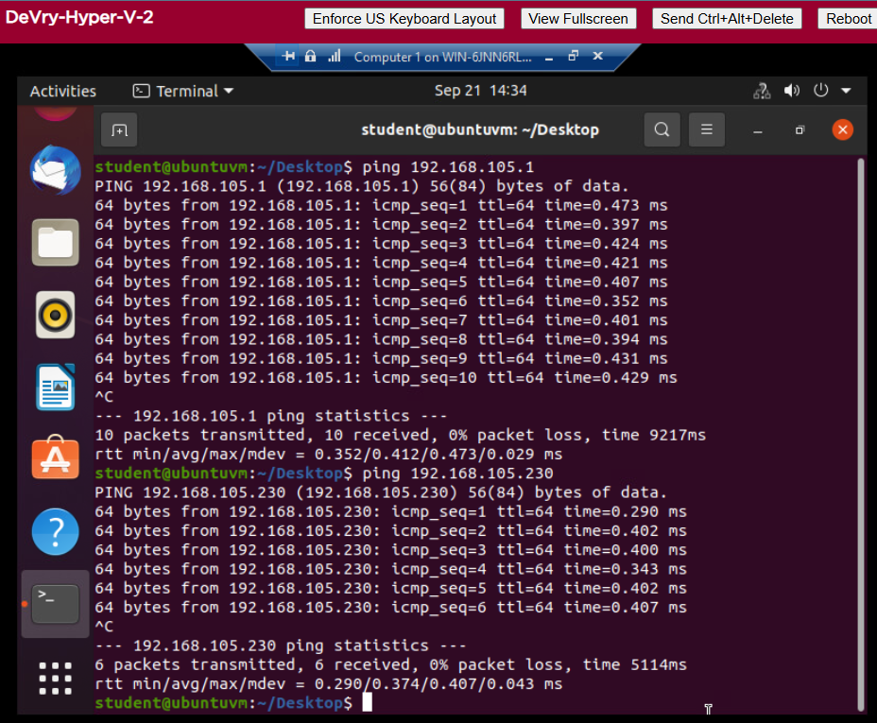
Connectivity Test
This provides evidence of a successful connectivity test for Computer 1 to the SOHO (Small Office/Home Office) router and computer 2. By pinging the IP address of the default gateway, I could check the connectivity to the router. This was also true with pinging the IP address of the Computer 2 VM.

Slide 11
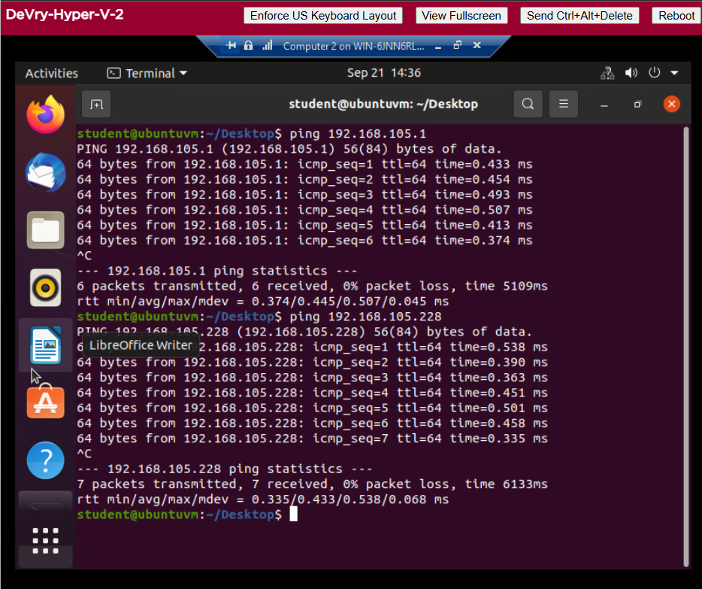
Connectivity Test (cont.)
Another successful connectivity check performed is evident by this screenshot. This time I was testing the connection between the Computer 2 VM to the SOHO router and then the connectivity to Computer 1 VM. Now I know that the network is established and the router as well as the virtual machines are connected.

Slide 12
Week 2 Takeaways
The network connectivity was able to be tested and was functioning as expected. The SOHO router and virtual computers had similar IP addresses because they were all connected to each other on the same network. The IP addresses all started with the “192.168.105” because that was the IP address issued to the router.

Slide 13
Week 3 Objectives
In the following slides for the third objective of the project, I will be taking a Class C network and dividing the IP addresses through subnetting. I will also be using Loopback interfaces on the router to simulate two LAN segments with the IP addresses in the subnet I created in the first step. I will test these IP addresses connectivity to determine if I successfully divided the network.

Slide 14
IP Subnetting
Subnet ID | Network Mask (/prefix) | Network Mask (Dotted decimal) | Network Address | First Usable Host Address | Last Usable Host Address | Broadcast Address
0 | /25 | 255.255.255.128 | 192.168.5.0 | 192.168.5.1 | 192.168.5.126 | 192.168.5.127
1 | /25 | 255.255.255.128 | 192.168.5.128 | 192.168.5.129 | 192.168.5.254 | 192.168.5.255
This table provides the information that is needed to create a subnet of the network. The network was divided in 2 separate subnets. Simple math can easily help you gather this information. Understanding how to find the CIDR notation, converting hexadecimal to binary, and binary back to hexadecimal are necessary to find these components. It’s important to understand that the first and last IP addresses in a subnet are used for the Network ID and Broadcast ID. Finding the range of IP addresses can help determine the potential number of devices one can have on a subnetted network.

Slide 15
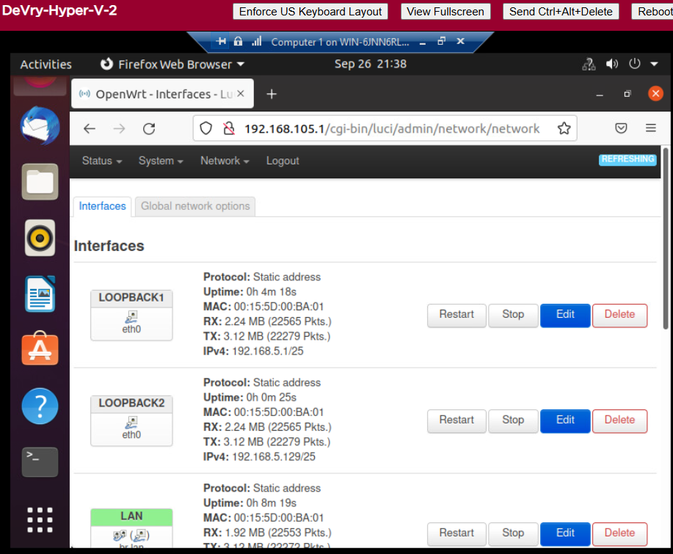
Loopback Interfaces
The Loopback interfaces were configured and activated. This enables device to transmit and receive data packets. Notice how each loopback establishes its own static IP address. These will remain active until told to shut down. The loopbacks can be used to help troubleshoot network issues and test network connectivity.

Slide 16
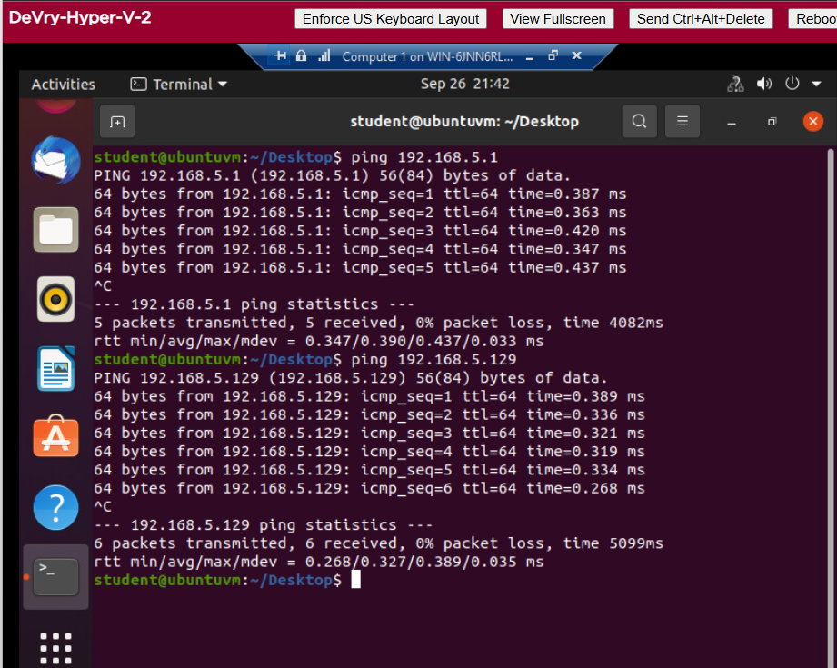
Connectivity Tests
As mentioned in the previous slide, we can test the network connectivity through the loopbacks. This screenshot demonstrates connectivity tests of Computer 1 to Loopback 1 and Computer 2 to Loopback 2.

Slide 17
Week 3 Takeaways
I was successful in subnetting the network and checking the connectivity of each network. I have further configured my network through the loopback interfaces and addresses. Also, I have demonstrated that I am able to promote the connectivity of my networks even when they were separated with subnetting. Both networks are now able to communicate with the SOHO router and transmit the necessary data packets.

Slide 18
Week 4 Objectives
For the fourth objective, I am going to show a diagram of the virtual machine and SOHO router environment that I have been working on. This includes information regarding the IP addresses, subnet masks and loopbacks. Please note a virtual switch is included to connect the SOHO router to the virtual machines.

Slide 19
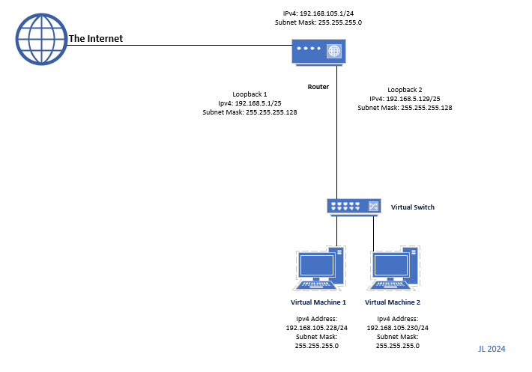
Microsoft Visio Network Diagram
This diagram illustrates the interconnection of the Computer 1 VM, the Computer 2 VM, and the SOHO Router VM along with proper IP addresses and labeling. This provides a visual of the network that I have been working on for this project.

Slide 20
Week 4 Takeaways
The topology shows the relationship between each device with the corresponding information. This helps anyone understand the relationship of each component of the network through visual means. With this diagram, I demonstrate my knowledge of how the network operates and communicates.

Slide 21
Week 5 Objectives
The last objective explores network security features through the use of a TP-Link emulator. This will allow me to explore configurations and see how to utilize functions such as MAC Filtering rules and wireless security settings. Understanding network security is a fundamental part of networking and keeping sensitive data safe from unauthorized users. In the following slides, I was asked questions regarding features and security measures within the emulator.

Slide 22
SOHO Wireless Network Security 1 of 3
1. What are the factory default username and password of a TP-Link router? Why is it important to change the default username and password of a SOHO router?
Answer: The default username and password is “ admin “ for a TP-Link router. It is important to change the default router because this default information is universal to all routers and can be easily looked up online. Not changing the default username and password leaves your router and the network vulnerable.
2. To protect a SOHO wireless network with a small number of devices, which address management method provides more control, configuring the device IP addresses manually (static IP) or using a DHCP server (dynamic IP)? Why?
Answer: The static IP configuration has more control because you set the IP addresses manually and they don’t change. When you set the IP addresses especially for critical devices, you can manage the network configurations and easily identify network issues.

Slide 23
SOHO Wireless Network Security 2 of 3
3. What does MAC filtering do? If needed, when would you use deny filtering rules and when would you use allow filtering rules? What happens to devices that want to connect, if the “Allow the stations specified by any enabled entries in the list to access” function is enabled but there are no entries in the list?
Answer: MAC filtering controls the access to the network based on the MAC address of a device. You would use the deny filtering rules to deny known devices that you do not want on the network, such as personal devices on a company’s network. You can also configure using the allow filtering rules to allow only the devices that you want on the network and block all other devices. If you have the “allow the stations specified by any enabled entries in the list to access” function enabled without any entries, no device will have access to the network because the router does not have a list of devices to allow.
4. What wireless security settings are displayed on the Wireless Security page? Which one is recommended by the vendor? Why?
Answer: The security settings on this page display the disable wireless security, WPA/WPA2Personal and Enterprise, and WEP. The recommended setting is WPA/WPA-2 Personal using version WPA2-PSK with AES encryption. These settings are recommended by the vendor because they are the most up-to-date security settings that are offered for this router. They would provide the best security options without slowing down the network.

Slide 24
SOHO Wireless Network Security 3 of 3
5. Among the configurations you explored in this module, which one is a true security function? Why?
Answer: After exploring these configurations, I believe the WPA2-PSK with AES encryption is the true security function. WPA2-PSK (Pre-Shared Key) is the most used and a strong encryption protocol used to secure wireless networks. AES (Advanced Encryption Standard) keeps wireless communication between devices secure. By enabling WPA2-PSK AES encryption, you ensure that the data transmitted over your wireless network is encrypted, making it much more difficult for unauthorized users to gain access to your data.
6. What would you do to protect your wireless network at home? Why?
Answer: I would change any default passwords and make them hard to guess as a first line of defense against attackers. I would then configure critical devices to have static IP addresses for better control over my network. I could setup MAC filtering to only allow the devices in my home to have access to my network because I feel that would provide the best defense in keeping unauthorized users from having access. I would configure the security to use WPA2-PSK with AES encryption which is the most widely used and secure protocol.

Slide 25
Week 5 Takeaways
This module demonstrated the security functions of a SOHO router and the configurations involved with making a network secure. I was able to configure settings and demonstrate my understanding of security features provided through the configurations.

Slide 26
Challenges
Most issues were technical and were easily resolved through simple troubleshooting such as adjusting the view of the virtual machines to capture all necessary information.
I did have trouble understanding the function of the loopback interfaces. This included where to include this information on the network diagram.

Slide 27
Career Skills
Networking skills
Network topology diagraming
Network troubleshooting
Knowledge of configurations
Knowledge of security protocols

Slide 28
Conclusion
In the previous slides, I have demonstrated how to find crucial information regarding a network and testing connectivity. I successfully established a network and then divided the network through subnetting. I was also able to visually provide a diagram of the network that I created. Each week, this project furthered my understanding of the fundamentals of a network. This includes understanding the importance of security within the network.

Slide 29
References
West, J. (2019). CompTIA Network+ Guide to Networks (9th ed.) [Ebook]. Cengage Learning, Inc.
TP-Link Emulator - https://www.tp-link.com/us/support/emulator/
Router Passwords. (2024, March 14). Router Passwords Community Database - The Wireless Router Experts. https://www.routerpasswords.com/
Hoffman, C., & Fitzpatrick, J. (2023, March 12). Wi-Fi security: Should you use WPA2-AES, WPA2-TKIP, or both? How-To Geek. https://www.howtogeek.com/204697/wi-fi-security-should-you-use-wpa2-aes-wpa2-tkip-or-both/

