Slide 1

CEIS106
Linux Operating System
Jaclyn Latshaw
May 2024

Slide 2
Introduction
Over several weeks, I have studied the basics of the Linux operating system.
Some topics include installation and common commands used to setup and maintain the integrity of the system.
In this presentation, I will be reviewing the fundamental concepts and features that are necessary to operate Linux.

Slide 3
What is Linux?
Linux was developed by Linus Torvald in 1991 based on the Unix operating system.
It is open sourced which means that the source code is freely available to be modified and redistributed.
There are over 600 Linux distributions!
Some of the most popular distributions are Debian, Ubuntu, Fedora, and Red Hat.

Slide 4
Basic Installation Information
Check computer specifications
You can use DVD or USB methods of installation or Linux can be installed as a virtual machine
Install to hard drive when ready
Set language, keyboard, and time settings
Partition the system for file distribution and usage
Must create 2 user accounts, root and regular
  Root has full rights to the system and should only be used to perform system administrative tasks

Slide 5
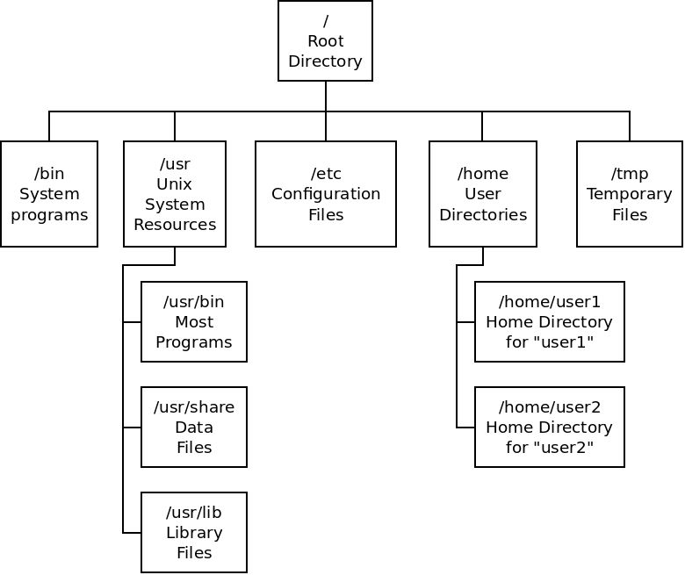
Linux Filesystem Tree
The Linux filesystem starts at the root and branches out like a tree.
All files and directories stem from the root directory.
Directories are special files that are used to organize other files in the tree.
A home directory can be created for users to store personal files.

Slide 6
Navigate the Linux filesystem tree
1. What is the pwd command an acronym for? What about the cd command?
Answer here:
PWD stands for Print Working Directory, and it is the command used to display the current directory in the directory tree.
CD, change directory, command is used to change the current directory in the directory tree.
2. Explain the differences between a relative path and an absolute/full path in Linux.
Answer here:
An absolute path is the full pathname from the root directory to a file or directory. The relative path is a pathname that is in relation to the current directory in the tree and does not show the full path from the root.
References:
1. MindTap course, Linux+ and LPIC-1 Guide to Linux Certification, Fifth Edition, Chapter 3

Slide 7
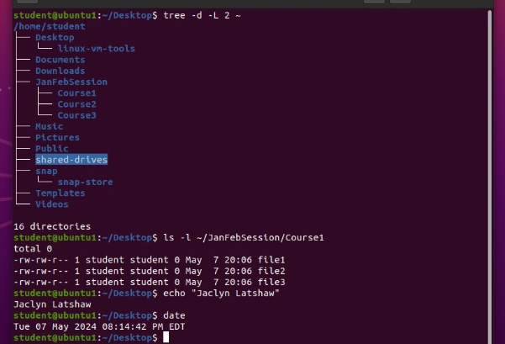
Create directories and files
This is an example of the filesystem tree in Linux. Also shown is the ls command which lists the files in a given directory.

Slide 8
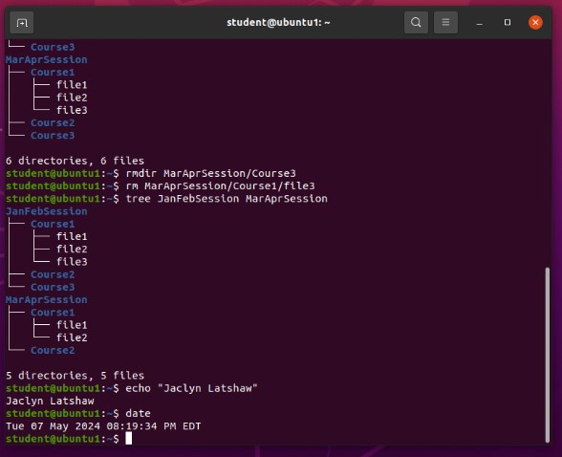
Copy and remove directories and files
Some common commands for directories are mkdir (make directory), mv (move directory), and rmdir (remove directory).
Files can be copied with the cp command.

Slide 9
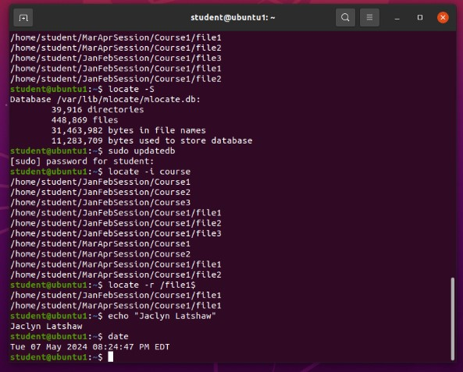
Locate directories and files
You can find files in a few different ways such as using the locate command or the find command.

Slide 10
Shells and Shell Scripts
A shell is a user interface that accepts input from the user and passes the input to the kernel for processing.
  The default for Linus is the BASH (Bourne Again Shell).
A shell script is a text file that contains commands for the shell to execute
Shell scripts can contain if and loop constructs in order to execute specific commands based on if parts are true/false or if commands need to be repeated until a desired result is reached.

Slide 11
Create a shell script
1. What are the file permissions of the script?
Answer here:
The default permissions of the script are “-rw-rw-r--” which means that the user and group have read and write permissions. Other only has read permissions. No one has execute permissions.
2. What’s the name of the user-defined variable in the script?
Answer here:
The user-defined variable is “$text” and tells the script that the user input is what should be filled in whenever the script encounters this variable.
3. Which redirection meta-character is used in the script? What does it do?
Answer here:
The meta-character used for redirection is “>>”. This allows redirection that prevents the file from being cleared by the BASH shell and appends the output to the existing output.
References:
1. Mindtap - Cengage

Slide 12
Variables & Metacharacters
Environment variables are system-wide and convey information to software and shape how programs interact with the environment.
  An example is pwd which shows the current directory.
  You can view a list of variables in the shell by using the set command.
Metacharacters are used to add special meaning to commands
  Asterisk (*) matches occurrences of a character
  Question mark (?) matches a single character
  Brackets ([]) indicate a character range

Slide 13
Types of Permissions
Files have permissions assigned to them to ensure that the right people or group of people have the ability to read, write, or execute important files.
Each is represented by a single letter: Read (r), Write (w), and Execute (x)
Permissions can be given to an individual, a group, or other.
If a permission is not given, it is represented by a dash (-)
These can be changed using the chmod command.
To set default permissions for new files or directories, you can use the umask command.

Slide 14
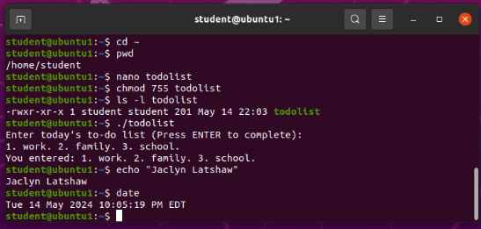
Change script file permissions
Here is an example of changing file permissions using the numerical method with chmod command. Each digit represents the individual, group, or other permissions. The numerical value is determined by which file permissions are activated.
Read is 4. Write is 2. Execute is 1. None is 0.
In the example, 755 is given which means the following:
The individual has all permissions
Groups have read and execute permissions.
Other also has read and execute permissions.

Slide 15
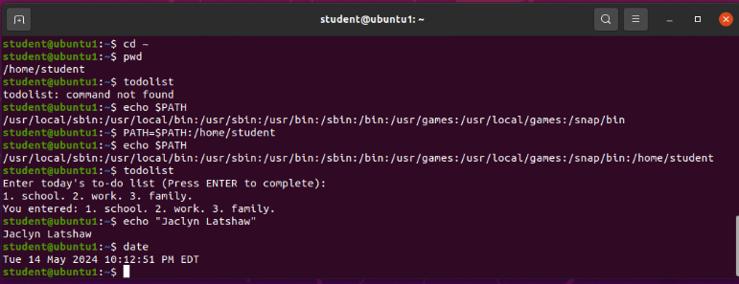
Set the PATH variable
In this example, a to-do list script was created. I set the PATH variable to help the system recognize where the script was located for the script to work properly.

Slide 16
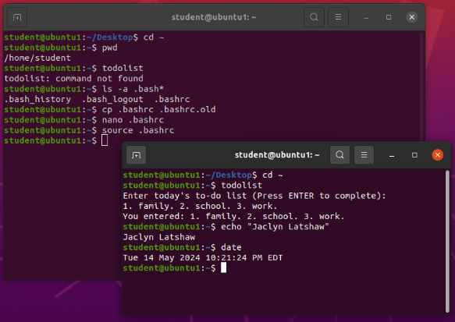
Make the PATH variable permanent
This is an example of creating a shell script. Here the todolist script is run before and after making the PATH variable permanent.

Slide 17
Adding Users
You can add users to a Linux server using the useradd command.
  Example: useradd Jaclyn
    This will add Jaclyn as a user to the system.
You can set a password for the user using passwd command.
  Passwords can be modified for expiration information using the chage command.
Modifying user accounts is done through the usermod command.
You can remove user accounts through the userdel command.
  This is not recommended if the user’s files are still needed because this command will also delete all files for that user.

Slide 18
Adding Groups
Adding groups is similar to adding users.
The groupadd command adds a group to the system.
To change the name of the group, use the groupmod command.
To delete a group, use the groupdel command.
To see what groups a user is a part of, use the group command for a list.
  You can also use the id command to list the user and group identifiers.

Slide 19

Add users and groups in CLI
1. What does the –m option in the useradd command do?
Answer here: This option specifies a home directory to be created for the user being added.
2. What does the -3 option in the tail command do?
Answer here: The tail command prints the last lines of a file. With the “-3” option, this is telling the command to print the last 3 lines of the file.
3. Which line of the /etc/group file lists members of the “students” group? Copy it here.
Answer here:
References:
1. MindTap - Cengage
2. Live Lecture

Slide 20
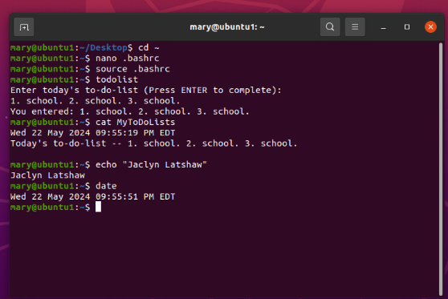
Test user and group settings
Recall from before the to-do list command that was created, the permissions were changed to allow individual users all permissions. This shows that the user, Mary, can view the MyToDoLists file that is created when using the to-do list command.

Slide 21
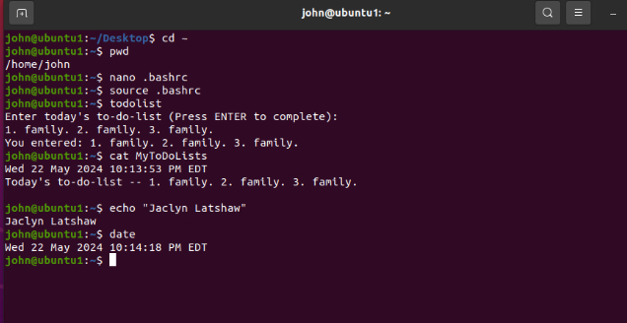
Add users in GUI
Another user, John, was added to the system. After John was added to the system, his permissions were then tested with the MyToDoLists file after he created his own to-do list using the command. This shows that John and Mary both have executable permissions.

Slide 22
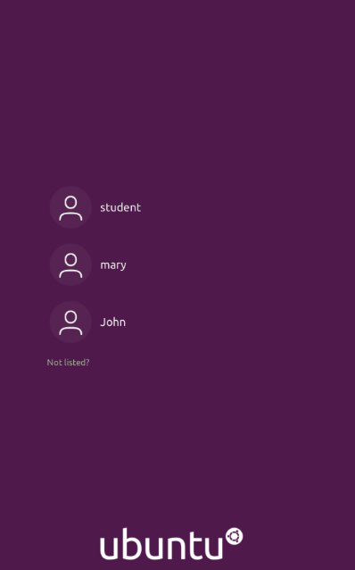
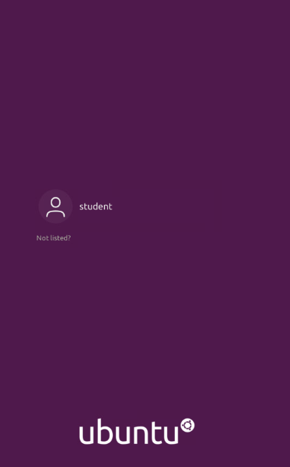

Remove users and groups
This is an example of a Graphical User Interface (GUI) that lists the different accounts that were created through the Linux command line. When users are removed, the graphical interface will also update and remove them as well.

Slide 23
Networks
A network is two or more computers that are connected in order to exchange information.
Routers transfer information from one network to another.
The information sent needs to be organized by a set of protocols.

Slide 24
Security Risks
There are many ways to increase the overall security of your network.
Some examples:
  Limit physical access to the computer
  Limit root user access
  Enable passwords and change them regularly
  Use encryption to prevent access to files
  Configuring firewalls and changing default ports
  Checking for vulnerabilities

Slide 25
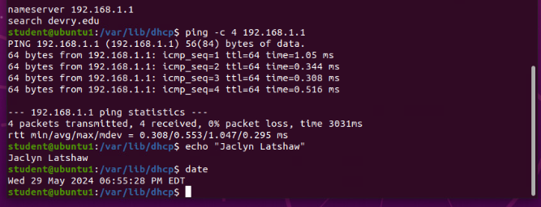
Discover host IP configurations
1. What is the IP address of your Ubuntu machine?
Answer here: 192.168.1.107
2. What is the IP address of its default gateway?
Answer here: 192.168.1.1
3. What is the IP address of its DHCP server?
Answer here: 192.168.1.1
4. What is the IP address of its DNS server?
Answer here: 192.168.1.1
The ping command is used to check the connectivity of a network. Below is an example.

Slide 26
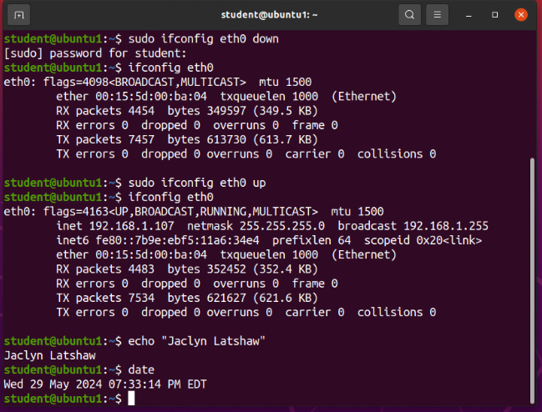
Use network utilities
The ifconfig command is used to view and configure the status of network interfaces. The example shows the interface is running and how the output for each command is different depending on what is enabled.

Slide 27
Monitor Linux processes
1. What is the default action of the 15 SIGTERM kill signal?
Answer here: It kills the process that is currently highlighted.
2. In the System Monitor window, click on % CPU to sort the processes by CPU load. Which process shows the highest percentage of CPU usage?
Answer here: The gnome-shell is using the highest percentage of CPU usage.
References:
1. Live Lecture
2. Infosec Learning Console

Slide 28
Monitor user activities
Issue the sudo accton on command to turn on GNC accounting. Run the sudo updatedb command. Enter lastcomm updatedb to check if the updatedb command was executed before. Remember to turn off GNC accounting (sudo accton off) after answering the questions.
1. What flag value is displayed in the output?
Answer here: S for superuser
2. Why is the name of the user who ran the processes shown as root, not student?
Answer here: The user used the sudo command to elevate their permissions to that of a superuser.
References:
1. Live Lecture

Slide 29
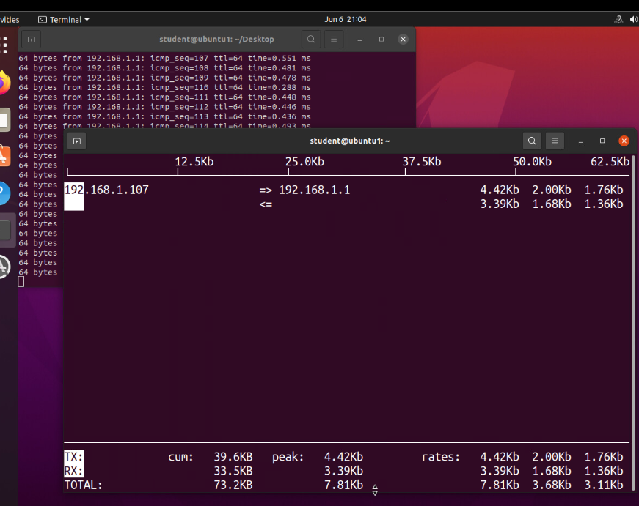
Monitor network bandwidth usage
This example shows the values of bandwidth being used while pinging the network. The output is showing how the network is functioning and how much bandwidth is being used.

Slide 30
Help and Information
If at any time you are unsure about commands, Linux has built in resources to help you.
Manual pages, man command, is the manual for the Linux software that provides detailed command syntax documentation
The help command provides information on a specific command.
  Example: help cd
    This will provide information on the change directory (cd) command

Slide 31
Challenges
Switching to a new operating system that I was unfamiliar with
  I primarily use Microsoft Windows.
Using a command line instead of a graphical interface to interact with the system

Slide 32
Career Skills
Setting up and managing Linux
Network Security and Practices
Troubleshooting issues
Testing software and applications

Slide 33
Conclusion
Linux is a fascinating operating system that many people use for the stability and reliability. It is customizable and can be run on many different devices. Linux is very easy to learn and a great introduction to operating systems and essential I.T. skills.

